Slide 1
Response of Majorana Electric Multipoles to Strain
in Topological Crystalline Superconductors
Nagoya Univ¹., RIKEN (CEMS)²
Yuki Yamazaki¹, Shingo Kobayashi², Ai Yamakage¹

Slide 2
Topological Superconductor (TSC)
E
Bulk
A fully or partially (bulk) gapped superconductor with a gapless state on the surface of the system
MFs
k
The surface states behave as a Majorana fermions (MFs)
Semiconductor nanowire of InSb
Tunneling conductance
One-dimensional
(1D) TSC
MFs on a edge of the system
Zero bias peak
due to MFs
3D TSC
MFs on a surface
of the system
Conductance by PCS
in Ag paste part

Slide 3
Topological superconductor with time-reversal symmetry (TRS)
・ MFs form a Kramers pair (Majorana Kramers pair (MKP))
・ a single MKP is stable for perturbations that do not break the TRS
Do MKP necessarily vanish due to breaking of TRS? (applied magnetic field)
Bulk
E
E
？
Magnetic field B
MFs
k
k
MKPs remain gapless when a magnetic field is applied in a
specific direction (MKPs exhibit anisotropic magnetic response)
M. Sato and S. Fujimoto, Phys. Rev. B 79, 094504 (2009).
SB. Chung and S.C. Zhang, Phys. Rev. Lett. 103, 235301 (2009).
MKPs are protected by crystalline symmetry
K. Shiozaki and M. Sato, Phys. Rev. B 90, 165114 (2014).

Slide 4
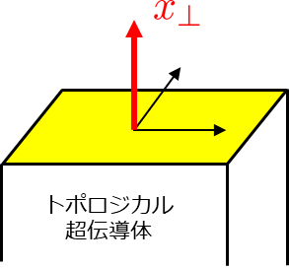
Y. Xiong, A. Yamakage, S. Kobayashi, M. Sato, and Y. Tanaka, Crystals 7, 58 (2017).
S. Kobayashi, A. Yamakage, Y. Tanaka, and M. Sato, Phys. Rev. Lett. 123, 097002 (2019).
TRS + Crystalline symmetry（Topological crystalline superconductor）
Crystalline symmetry preserving the surface
TCSC
Magnetic winding number
Chiral symmetry
Zeeman term
There is a direction of the magnetic field
where chiral symmetry is not broken!
Anisotropic Magnetic Response＝Majorana Magnetic Multipole
Bulk
B
MFs

Slide 5
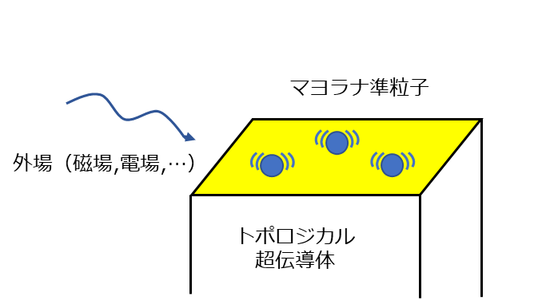
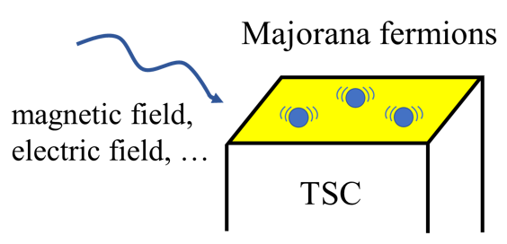
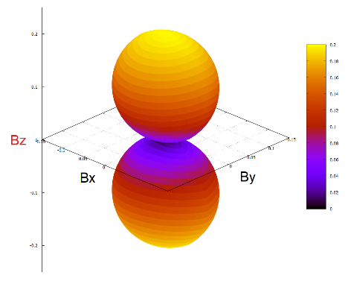
What can we know from the external
field response of MFs?
Crystalline
symmetry
Detection of MFs
TCSC
Bｚ
superconducting
symmetry
Identification of
superconducting symmetry

Slide 6
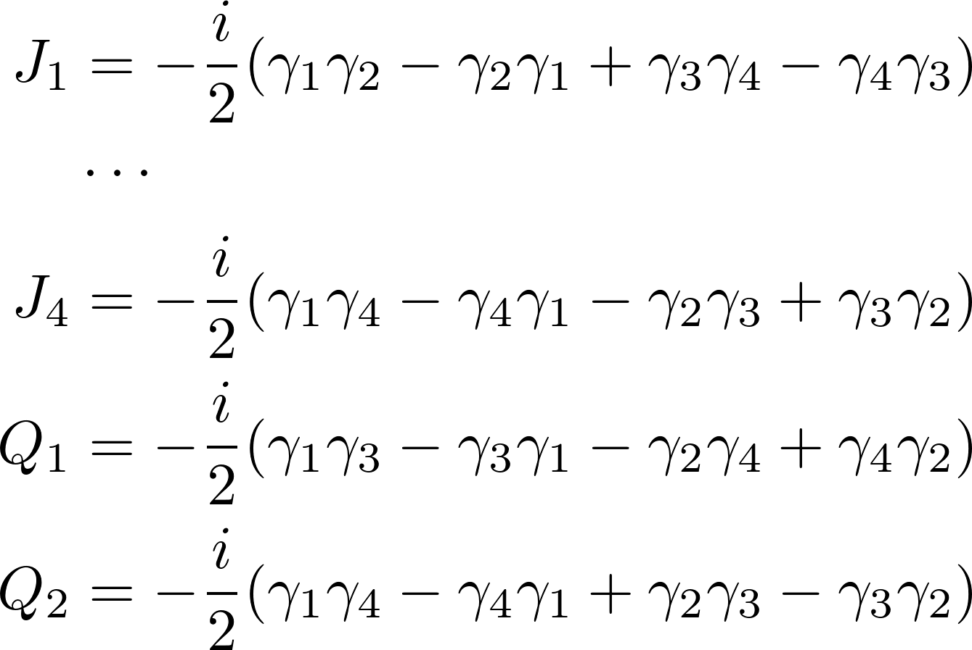
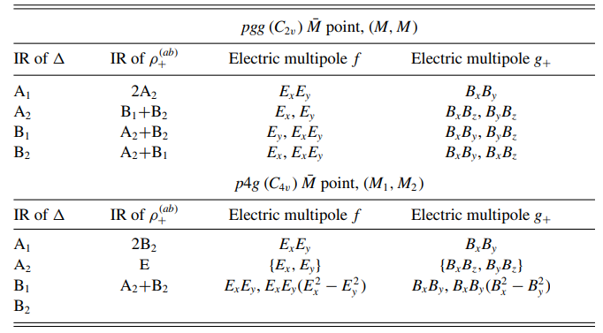
Majorana Electric Multipole (MEM)
TRS
Only a single MKP（ ） is stable （ ）
Majorana
Operator
Coupled only with
magnetic field
TRS + Crystalline symmetry
In some cases, double MKPs are stable
Y. Yamazaki, S. Kobayashi, and A. Yamakage,
J. Phys. Soc. Jpn. 89, 043703 (2020).
S. Kobayashi, Y. Yamazaki, A. Yamakage,
and M. Sato, Phys. Rev. B 103, 224504 (2021).
Owing to the crystalline symmetry, there are electric multipoles with various symmetries
Bulk
Magnetic field
MFs
Electrical
external field

Slide 7
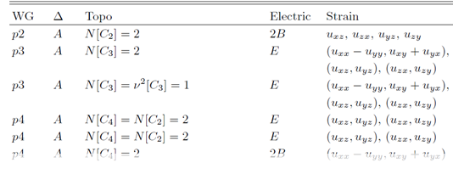
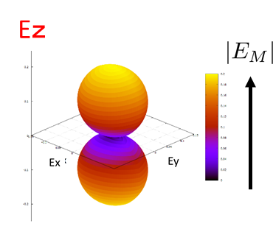
Purpose of our study
To reveal the symmetry of the Majorana electric multipole
for all wall paper groups (WGs) and pair potentials
Result
Y. Yamazaki, S. Kobayashi, and A. Yamakage,
J. Phys. Soc. Jpn. 90, 073701 (2021).
Detection of MFs
Crystalline symmetry
superconducting
symmetry
Identification of
superconducting symmetry

Slide 8
Coupling between Majorana Electric Multipoles (MEM) and Strain
We consider the strain tensor as a perturbation coupled to the MEM
Lattice displacement field：
Unsymmetrized strain tensor：
Transformation property by the symmetry operator g：
When the electric multipole and belong to the same irreducible representation,
they are coupled, and the coupling can be described as
where denotes irreducible representations of , and i corresponds to the degrees of freedom of the MEM; i=1,2 for two pairs of MKPs.
Electrical
external field

Slide 9
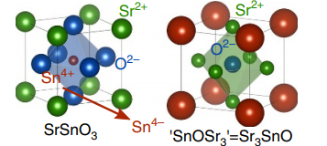
Coupling between Majorana Electric Multipoles (MEM) and Strain
In this study, we consider as an effective model an antiperovskite that is a candidate material for TCSC, and where double MKPs can appear on the (001) surface
（point group Oh）
Effective model
T. Kawakami, T. Okamura, S. Kobayashi,
and M. Sato: Phys. Rev. X 8, 041026 (2018).
The matrices reflect multi-orbital properties：
Inversion symmetry：
The (001) surface respects the p4m symmetry
M. Oudah, A. Ikeda, J. N. Hausmann, S. Yonezawa,
T. Fukumoto, S. Kobayashi, M. Sato, and Y. Maeno:
Nat. Commun. 7, 13617 (2016).
If the strain of or is applied, it couples to the MEM, and an energy gap opens

Slide 10
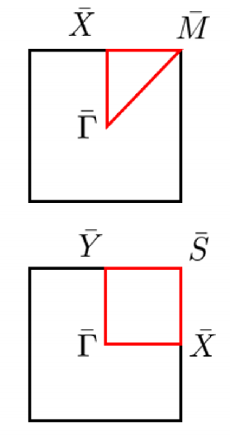
In this situation, we consider the following perturbation
Perturbation Hamiltonian
A1 irrep
B1 irrep

Slide 11
Summery
We have revealed the relation between the symmetry of Majorana Electric multipole and irreducible representation of the superconducting pair potential for all wall paper groups
We consider the lattice strain as an electrical perturbation and
numerically clarify the coupling with the Majorana electric multipole
Future works
Return to the bulk theory, and derive the microscopic mechanism of the coupling between the strain and MKPs
Consider dynamical strains such as induced surface acoustic waves, and calculate the spin currents and heat currents generated by dynamical strains

