Slide 1
Maximum vanishing subspace problem,
CAT(0)-space relaxation, and block-triangularization of partitioned matrix
Hiroshi Hirai
University of Tokyo
hirai@mist.i.u-tokyo.ac.jp
Joint work with Masaki Hamada
10th Japanese-Hungarian Symposium on
Discrete Mathematics and Its Applications
May 23, 2017, Budapest, Hungary

Slide 2


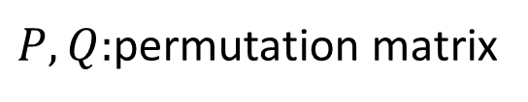









DM-decomposition of matrix
(Dulmage-Mendelsohn 1958)
A canonical form under row/column permutation
Matching/stable set problem in bipartite graph
$$∗$$
$$∗$$
$$∗$$
$$A ↦PAQ=$$
$$∗$$
$$∗$$
$$∗$$
$$0$$
$$∗$$
$P,Q:$permutation matrix
$$∗$$
$$∗$$

Slide 3



















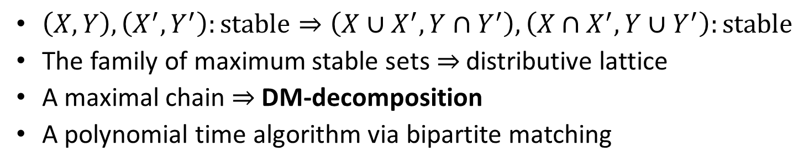





$$edge ij ⟺a_{ij}≠0$$
$$1′$$
$$1^{′} 2^{′} 3^{′}$$
$$Y$$
$$1$$
*
$$1$$
$$2′$$
$$2$$
*
*
$$X_{3}$$
$$2$$
$$3′$$
*
*
$$3$$
$$X_{2}$$
$$X_{1}$$
*
$$X$$
$$0$$
*
$$X_{0}$$
$$X$$
*
$$Y$$
$$Y_{3}$$
$$Y_{2}$$
$$Y_{1}$$
$$Y_{0}$$
$$A=(a_{ij})$$
bipartite graph
zero submatrix
stable set
(max.)
(max.)
$\left(X,Y\right),\left(X^{′},Y^{′}\right):\text{stable}⇒\left(X∪X^{′},Y∩Y^{′}\right),\left(X∩X^{′},Y∪Y^{′}\right):\text{stable}$
The family of maximum stable sets$⇒$ distributive lattice
A maximal chain $⇒$ DM-decomposition
A polynomial time algorithm via bipartite matching

Slide 4





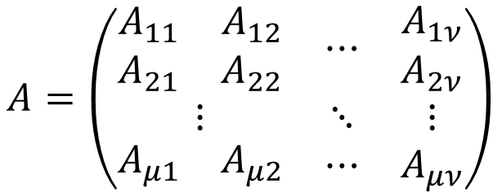



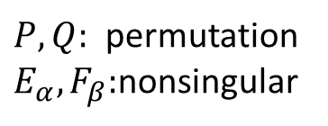


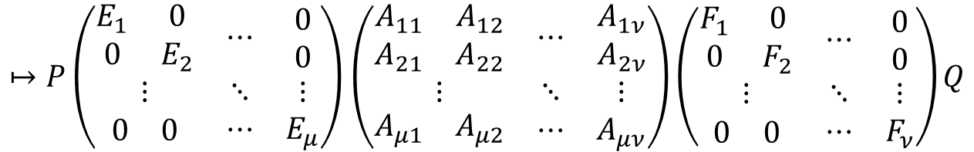


DM-decomposition of partitioned matrix
(Ito-Iwata-Murota 1994)
$$A=\left(\begin{matrix}\begin{matrix}A_{11} & A_{12} \\ A_{21} & A_{22}\end{matrix} & ⋯ & \begin{matrix}A_{1ν} \\ A_{2ν}\end{matrix} \\ ⋮ & ⋱ & ⋮ \\ \begin{matrix}A_{μ1} & A_{μ2}\end{matrix} & ⋯ & A_{μν}\end{matrix}\right)$$
$A_{αβ}:m_{α}×n_{β}$ matrix
$$↦P\left(\begin{matrix}\begin{matrix}E_{1} & 0 \\ 0 & E_{2}\end{matrix} & ⋯ & \begin{matrix}0 \\ 0\end{matrix} \\ ⋮ & ⋱ & ⋮ \\ \begin{matrix}0 & 0\end{matrix} & ⋯ & E_{μ}\end{matrix}\right)\left(\begin{matrix}\begin{matrix}A_{11} & A_{12} \\ A_{21} & A_{22}\end{matrix} & ⋯ & \begin{matrix}A_{1ν} \\ A_{2ν}\end{matrix} \\ ⋮ & ⋱ & ⋮ \\ \begin{matrix}A_{μ1} & A_{μ2}\end{matrix} & ⋯ & A_{μν}\end{matrix}\right)\left(\begin{matrix}\begin{matrix}F_{1} & 0 \\ 0 & F_{2}\end{matrix} & ⋯ & \begin{matrix}0 \\ 0\end{matrix} \\ ⋮ & ⋱ & ⋮ \\ \begin{matrix}0 & 0\end{matrix} & ⋯ & F_{ν}\end{matrix}\right)Q$$
$$∗$$
$P,Q:$ permutation
$E_{α},F_{β}:$nonsingular
$$∗$$
$$∗$$
$$=$$
$$∗$$
$$∗$$
$$∗$$
$$0$$
$$∗$$
$$∗$$
$$∗$$

Slide 5
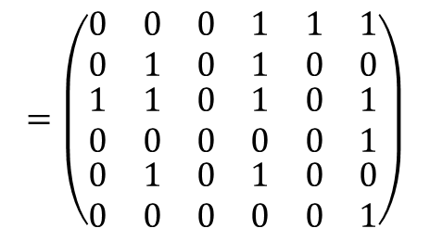
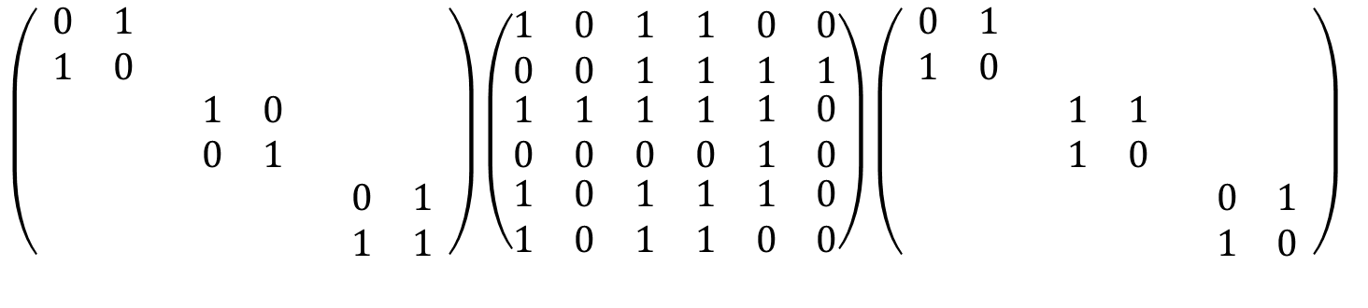
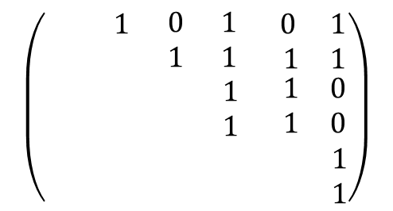
Example: (2,2,2;2,2,2) matrix over GF(2)
$\left(\begin{matrix}\begin{matrix}\begin{matrix}0 & 1 \\ 1 & 0\end{matrix} & \begin{matrix} & \\ & \end{matrix} \\ \begin{matrix} & \\ & \end{matrix} & \begin{matrix}1 & 0 \\ 0 & 1\end{matrix}\end{matrix} & \begin{matrix}\begin{matrix} & \\ & \end{matrix} \\ \begin{matrix} & \\ & \end{matrix}\end{matrix} \\ \begin{matrix}\begin{matrix} & \\ & \end{matrix} & \begin{matrix} & \\ & \end{matrix}\end{matrix} & \begin{matrix}0 & 1 \\ 1 & 1\end{matrix}\end{matrix}\right)\left(\begin{matrix}\begin{matrix}\begin{matrix}1 & 0 \\ 0 & 0\end{matrix} & \begin{matrix}1 & 1 \\ 1 & 1\end{matrix} \\ \begin{matrix}1 & 1 \\ 0 & 0\end{matrix} & \begin{matrix}1 & 1 \\ 0 & 0\end{matrix}\end{matrix} & \begin{matrix}\begin{matrix}0 & 0 \\ 1 & 1\end{matrix} \\ \begin{matrix}1 & 0 \\ 1 & 0\end{matrix}\end{matrix} \\ \begin{matrix}\begin{matrix}1 & 0 \\ 1 & 0\end{matrix} & \begin{matrix}1 & 1 \\ 1 & 1\end{matrix}\end{matrix} & \begin{matrix}1 & 0 \\ 0 & 0\end{matrix}\end{matrix}\right)\left(\begin{matrix}\begin{matrix}\begin{matrix}0 & 1 \\ 1 & 0\end{matrix} & \begin{matrix} & \\ & \end{matrix} \\ \begin{matrix} & \\ & \end{matrix} & \begin{matrix}1 & 1 \\ 1 & 0\end{matrix}\end{matrix} & \begin{matrix}\begin{matrix} & \\ & \end{matrix} \\ \begin{matrix} & \\ & \end{matrix}\end{matrix} \\ \begin{matrix}\begin{matrix} & \\ & \end{matrix} & \begin{matrix} & \\ & \end{matrix}\end{matrix} & \begin{matrix}0 & 1 \\ 1 & 0\end{matrix}\end{matrix}\right)$
$$=\left(\begin{matrix}\begin{matrix}\begin{matrix}0 & 0 \\ 0 & 1\end{matrix} & \begin{matrix}0 & 1 \\ 0 & 1\end{matrix} \\ \begin{matrix}1 & 1 \\ 0 & 0\end{matrix} & \begin{matrix}0 & 1 \\ 0 & 0\end{matrix}\end{matrix} & \begin{matrix}\begin{matrix}1 & 1 \\ 0 & 0\end{matrix} \\ \begin{matrix}0 & 1 \\ 0 & 1\end{matrix}\end{matrix} \\ \begin{matrix}\begin{matrix}0 & 1 \\ 0 & 0\end{matrix} & \begin{matrix}0 & 1 \\ 0 & 0\end{matrix}\end{matrix} & \begin{matrix}0 & 0 \\ 0 & 1\end{matrix}\end{matrix}\right)$$
$$\left(\begin{matrix}\begin{matrix}\begin{matrix} & 1 \\ & \end{matrix} & \begin{matrix}0 & 1 \\ 1 & 1\end{matrix} \\ \begin{matrix} & \\ & \end{matrix} & \begin{matrix} & 1 \\ & 1\end{matrix}\end{matrix} & \begin{matrix}\begin{matrix}0 & 1 \\ 1 & 1\end{matrix} \\ \begin{matrix} 1 & 0 \\ 1 & 0\end{matrix}\end{matrix} \\ \begin{matrix}\begin{matrix} & \\ & \end{matrix} & \begin{matrix} & \\ & \end{matrix}\end{matrix} & \begin{matrix} & 1 \\ & 1\end{matrix}\end{matrix}\right)$$
row/column
permutation

Slide 6



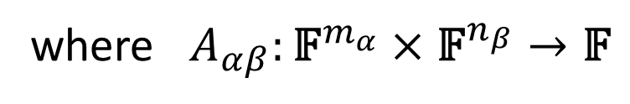
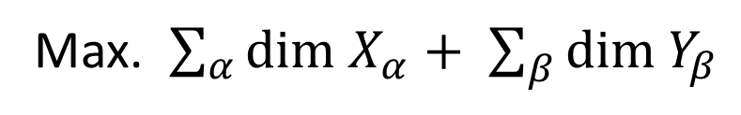

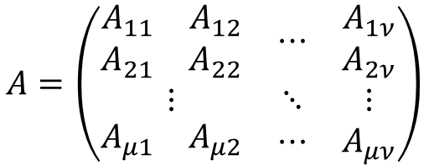
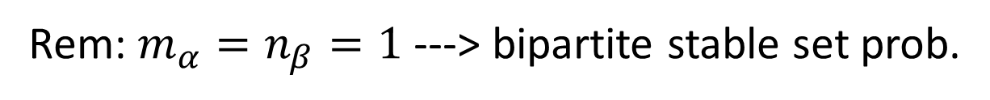
Maximum Vanishing Subspace Problem
(H.2016, Implicit in Ito-Iwata-Murota 1994)
$$A=\left(\begin{matrix}\begin{matrix}A_{11} & A_{12} \\ A_{21} & A_{22}\end{matrix} & ⋯ & \begin{matrix}A_{1ν} \\ A_{2ν}\end{matrix} \\ ⋮ & ⋱ & ⋮ \\ \begin{matrix}A_{μ1} & A_{μ2}\end{matrix} & ⋯ & A_{μν}\end{matrix}\right)$$
$$A_{αβ}:m_{α}×n_{β} \text{matrix} \text{over} \text{field} 𝔽$$
Max. $\sum_{α}{\text{dim}}$ $X_{α}+ \sum_{β}{\text{dim} Y_{β}}$
s.t.
$$X_{α} ⊆ 𝔽^{m_{α}} ,Y_{β} ⊆{ \text{𝔽}}^{n_{β}},$$
subsp.
subsp.
$$A_{αβ}\left(X_{α},Y_{β}\right)=\left\{0\right\} \left(∀α,β\right),$$
where $A_{αβ}:{\text{𝔽}}^{m_{α}}×{\text{𝔽}}^{n_{β}}→\text{𝔽}$
$$\left(u,v\right) ↦ u^{T}A_{αβ}v$$
Rem: $m_{α}=n_{β}=1$ ---> bipartite stable set prob.

Slide 7

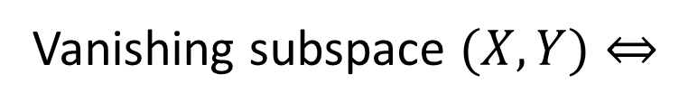

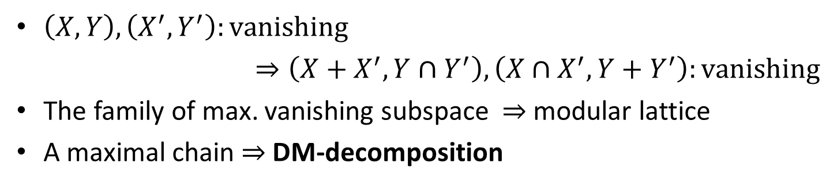







$$X=X_{1}⊕X_{2}⊕⋯⊕X_{μ}$$
Vanishing subspace $(X,Y)⇔$
$$Y=Y_{1}⊕Y_{2}⊕⋯⊕Y_{ν}$$
$$A_{αβ}\left(X_{α},Y_{β}\right)=\left\{0\right\} \left(∀α,β\right)$$
row/col operation “within blocks”
+ row/col permutation
$$A \sim$$
$$← \text{dim} X→$$
$$0$$
$$X$$
$$⟵ \text{dim} Y ⟶$$
$$Y$$
(max.)
$\left(X,Y\right),\left(X^{′},Y^{′}\right):\text{vanishing}$
$⇒\left(X+X^{′},Y∩Y^{′}\right),\left(X∩X^{′},Y+Y^{′}\right):\text{vanishing}$
The family of max. vanishing subspace $⇒$ modular lattice
A maximal chain $⇒$ DM-decomposition
(max.)

Slide 8
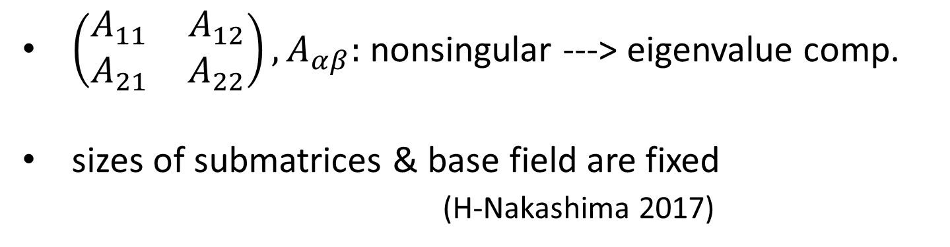
Polytime algorithm for DM-decom.
is not known in general
Special cases:
one submatrix ---> Gaussian elimination
each submatrix is 1x1 ---> original DM-decom.
each submatrix is *x1 ---> CCF of mixed matrix
each submatrix is rank-1 (H. 16)
Murota-Iri-Nakamura 87
matroid
intersection
$\left(\begin{matrix}A_{11} & A_{12} \\ A_{21} & A_{22}\end{matrix}\right),A_{αβ}:$ nonsingular ---> eigenvalue comp.
sizes of submatrices & base field are fixed
(H-Nakashima 2017)
VCSP

Slide 9
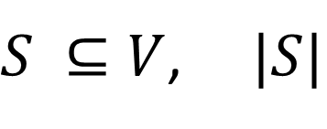
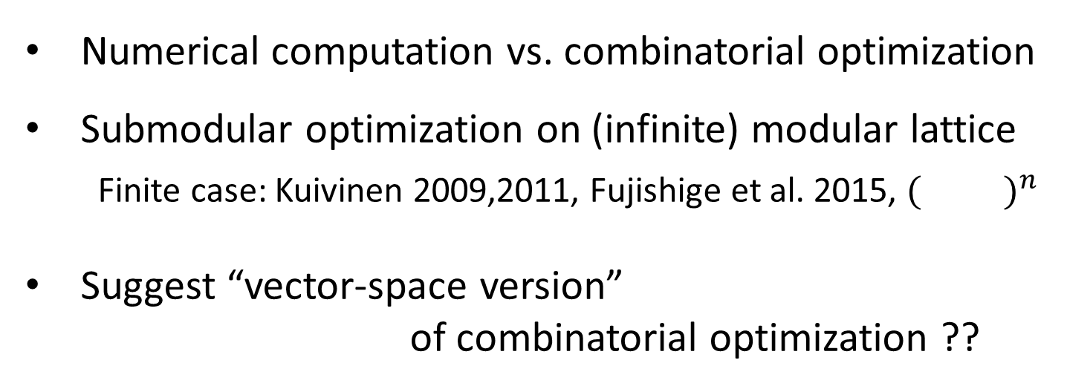


Why are MVSP & DM-decomposition
interesting?
Numerical computation vs. combinatorial optimization
Submodular optimization on (infinite) modular lattice
Finite case: Kuivinen 2009,2011, Fujishige et al. 2015, $({ )}^{n}$
Suggest “vector-space version”
of combinatorial optimization ??
$$⋯$$
$S ⊆V$, $|S|$
subset
finite set
cardinality
$$\text{dim} \text{S}$$
subspace
finite-dimensional
vector space
dimension

Slide 10
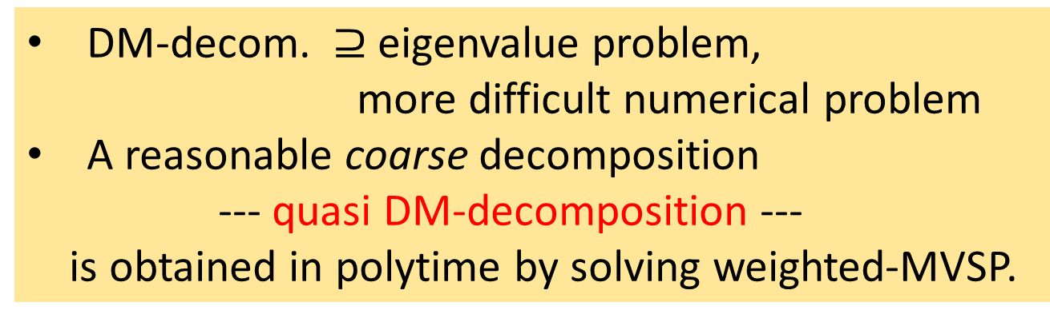
Result (answering the problem of Ito-Iwata-Murota 1994)
Q1. Is MVSP solvable in polynomial time ?
YES (Hamada-H. 2017)
Q2. Is DM-decom. obtained in polynomial time ?
Still we do not know the complete answer but...
DM-decom. $⊇$ eigenvalue problem,
more difficult numerical problem
A reasonable coarse decomposition
--- quasi DM-decomposition ---
is obtained in polytime by solving weighted-MVSP.
--- generalizes original-DM & CCF

Slide 11

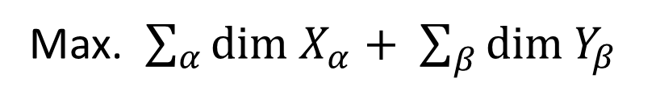
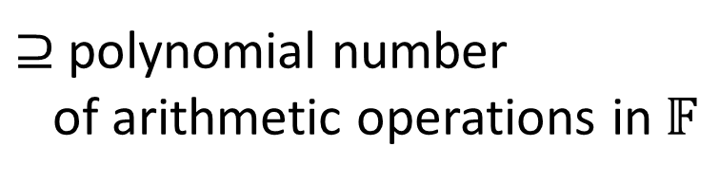

In the rest of the talk, we describe the outline of the proof
Theorem (Hamada-H. 2017)
MVSP is solvable in polynomial time
$⊇$ polynomial number
of arithmetic operations in$𝔽$
Max. $\sum_{α}{\text{dim}}$ $X_{α}+ \sum_{β}{\text{dim} Y_{β}}$
s.t.
$$X_{α} ⊆ 𝔽^{m_{α}} ,Y_{β} ⊆{ \text{𝔽}}^{n_{β}}$$
subsp.
subsp.
$$A_{αβ}\left(X_{α},Y_{β}\right)=\left\{0\right\} \left(∀α,β\right)$$
Difficulty:
Duality & LP/convex relaxation are not known

Slide 12



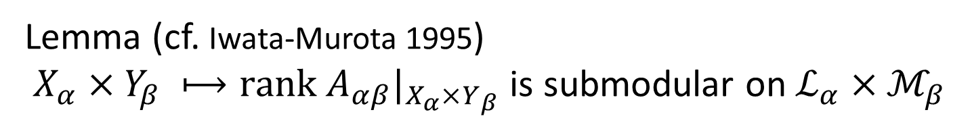
MVSP is submodular optimization
$$m+n+1$$
$Min. −\sum_{α}{\text{dim}}$ $X_{α}− \sum_{β}{\text{dim} Y_{β}}+M \sum_{α,β}{\text{rank} A_{αβ}|_{X_{α}×Y_{β}} }$
s.t.
$$(X_{1},X_{2},…,X_{μ},Y_{1},Y_{2},…,Y_{ν})$$
$$∈ℒ_{1}×ℒ_{2}×…×ℒ_{μ}×ℳ_{1}×ℳ_{2}×…×ℳ_{ν}$$
$ℒ_{α}/ℳ_{β}$: modular lattice of all vector subsp. in$𝔽^{m_{α}}/𝔽^{n_{β}}$
w.r.t.
inclusion
w.r.t. reverse
inclusion
$m≔\sum_{α}{m_{α}},n≔\sum_{β}{n_{β}}$
Lemma (cf. Iwata-Murota 1995)
$X_{α}×Y_{β} ⟼\text{rank} A_{αβ}|_{X_{α}×Y_{β}}$ is submodular on $ℒ_{α}×ℳ_{β}$

Slide 13


Outline : Beyond Euclidean convex relaxation
modular lattice
Submodular optimization on
distributive lattice
$$↪$$
Lovász extension
$$↪$$
Convex optimization on
Euclidean space
CAT(0)-space
MVSP is submodular optimization on modular lattice.
Splitting Proximal Point Algorithm (Bačák, Ohta-Pálfia)
to minimize sum of convex function in CAT(0)-space.
Apply SPPA to CAT(0)-space relaxation of MVSP.

Slide 14

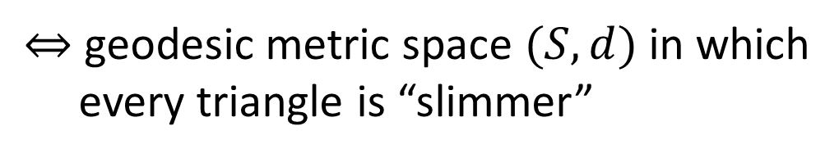












Cartan-Alexandrov-Topogonov
curvature $≤0$
CAT(0)-space (Gromov 87)
$⇔$ geodesic metric space $(S,d)$ in which
every triangle is “slimmer”
$$\overline{x}$$
$$ℝ^{2}$$
$$x$$
$$S$$
$$\overline{y}$$
$$\overline{p}$$
$$\overline{z}$$
$$y$$
$$p$$
$$z$$
$$d\left(x,y\right)={\left\|\overline{x}−\overline{y}\right\|}_{2}$$
$$d\left(y,z\right)={\left\|\overline{y}−\overline{z}\right\|}_{2}$$
$$d\left(z,x\right)={\left\|\overline{z}−\overline{x}\right\|}_{2}$$
$$d\left(x,p\right)≤{\left\|\overline{x}−\overline{p}\right\|}_{2}$$
FACT: CAT(0)-space is uniquely geodesic
---> convex function

Slide 15


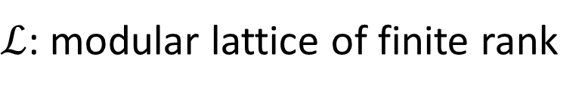






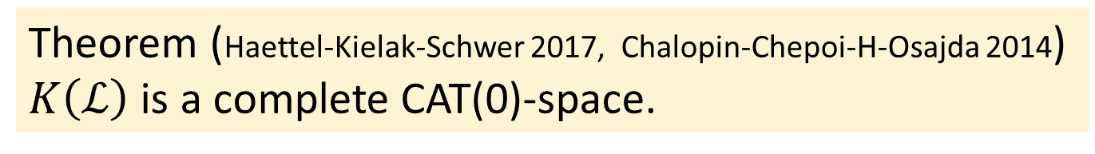

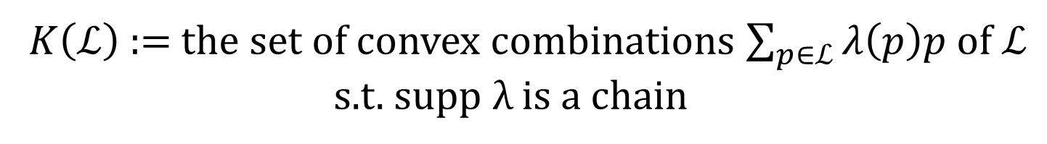


Modular lattice $↪$ CAT(0)-space
othoscheme complex
$ℒ$: modular lattice of finite rank
$K\left(ℒ\right)$ := the set of convex combinations $\sum_{p∈ℒ}{λ\left(p\right)p}$ of $ℒ$
s.t. $\text{supp} \text{λ}$is a chain
(Brady-McCammond 2012)
$$p_{3}$$
$$111$$
$$p_{2}$$
$${(ℝ}^{n},l_{2})$$
$$ℒ$$
$$p_{1}$$
$$110$$
$$p_{0}$$
$$000$$
$$100$$
Theorem (Haettel-Kielak-Schwer 2017, Chalopin-Chepoi-H-Osajda 2014)
$K\left(ℒ\right)$ is a complete CAT(0)-space.

Slide 16




Example
....
...
$$ℒ$$
$$K\left(ℒ\right)$$
$$ℒ=2^{\{1,2,…,n\}}$$
$$K\left(ℒ\right)≃{\left[0,1\right]}^{n}$$

Slide 17
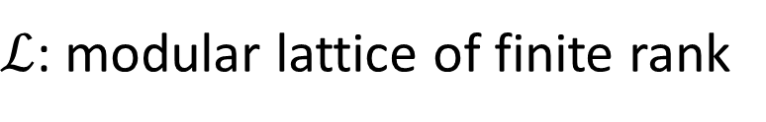

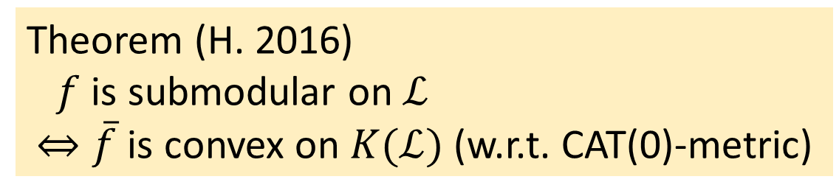
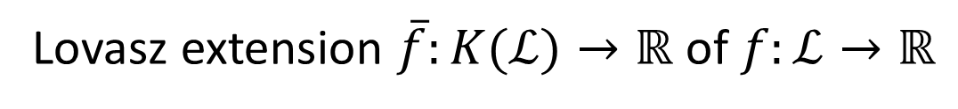
Submodular function
$↪$ convex function
$ℒ$: modular lattice of finite rank
Lovasz extension $\overline{f}:K(ℒ)→ℝ$ of $f:ℒ→ℝ$
$\overline{f}\left(x\right)≔ \sum_{i}{λ_{i}f(p_{i})}$ $(x=\sum_{i}{λ_{i}p_{i}}∈K(ℒ))$
Theorem (H. 2016)
$f$ is submodular on $ℒ$
$⇔\overline{f}$ is convex on $K(ℒ)$ (w.r.t. CAT(0)-metric)
The original version: $ℒ=2^{\left\{1,2,…,n\right\}},K\left(ℒ\right)≃{[0,1]}^{n}$

Slide 18

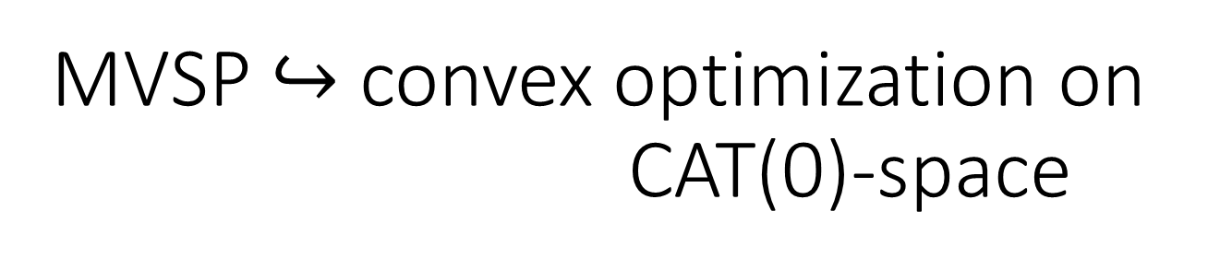
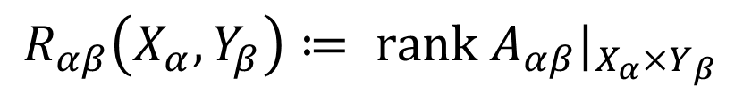

MVSP $↪$ convex optimization on
CAT(0)-space
$Min. −\sum_{α}{\overline{\text{dim}}}(x_{α})− \sum_{β}{\overline{\text{dim}}\text{(}y_{β})}+M \sum_{α,β}{\overline{R_{αβ}}(x_{α},y_{β})}$
s.t.
$$(x_{1},x_{2},…,x_{μ},y_{1},y_{2},…,y_{ν})$$
$$∈{K(ℒ}_{1}×ℒ_{2}×…×ℒ_{μ}×ℳ_{1}×ℳ_{2}×…×ℳ_{ν})$$
$$≅$$
$${K(ℒ}_{1})×K(ℒ_{2})×…×{K(ℒ}_{μ})×{K(ℳ}_{1})×{K(ℳ}_{2})×…×{K(ℳ}_{ν})$$
$$R_{αβ}\left(X_{α},Y_{β}\right)≔ \text{rank} A_{αβ}|_{X_{α}×Y_{β}}$$
We apply continuous optimization algorithm
to this problem

Slide 19
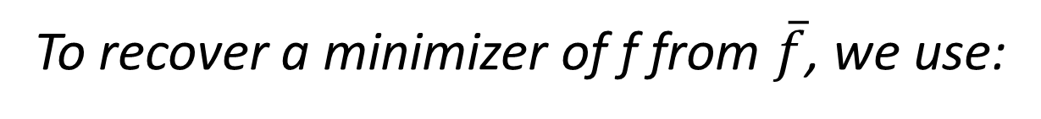
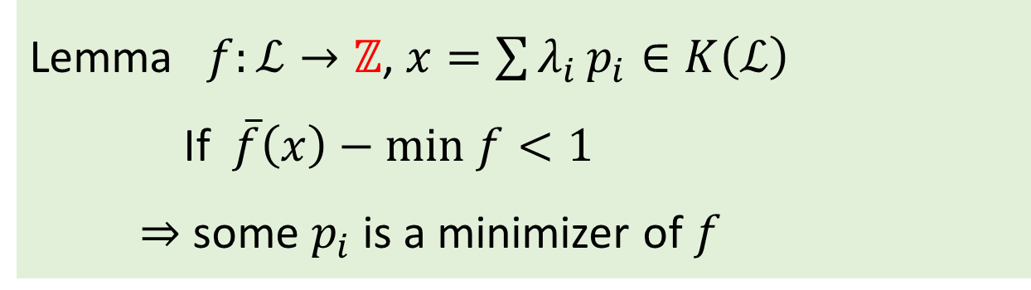
To recover a minimizer of f from $\overline{f}$, we use:
Lemma $f:ℒ→ℤ$, $x=\sum{λ_{i}}p_{i}∈K\left(ℒ\right)$
If $\overline{f}\left(x\right)−\text{min} f<1$
$⇒$ some $p_{i}$ is a minimizer of $f$

Slide 20
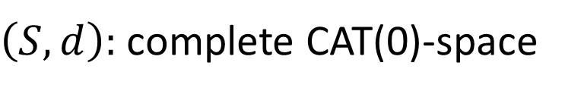
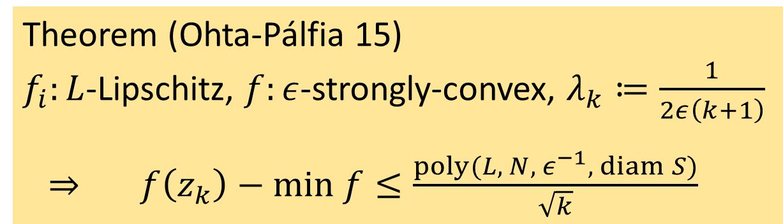
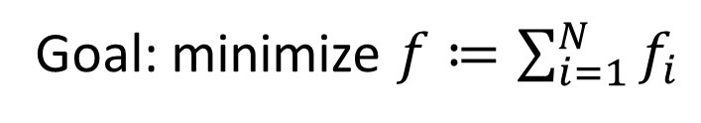
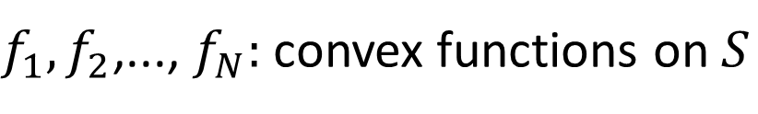
Splitting Proximal Point Algorithm
(Bačák 14)
$\left(S,d\right):$ complete CAT(0)-space
$f_{1},f_{2}$,..., $f_{N}:$ convex functions on $S$
Goal: minimize $f≔\sum_{i=1}^{N}{f_{i}}$
SPPA: $z_{k+1}≔{\text{argmin}}_{z ∈ S} f_{k mod N }\left(z\right)+\frac{1}{2λ_{k}}{d(z,z_{k})}^{2}$
Theorem (Ohta-Pálfia 15)
$f_{i}:L$-Lipschitz, $f:ε$-strongly-convex, $λ_{k}≔\frac{1}{2ε\left(k+1\right)}$
$⇒$ $f\left(z_{k}\right)−\text{min} f≤\frac{poly(L, N, ε^{−1}, diam S)}{\sqrt{k}}$

Slide 21
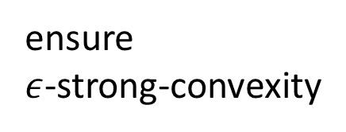

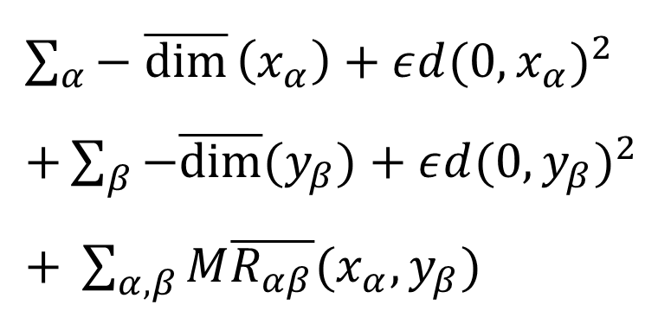
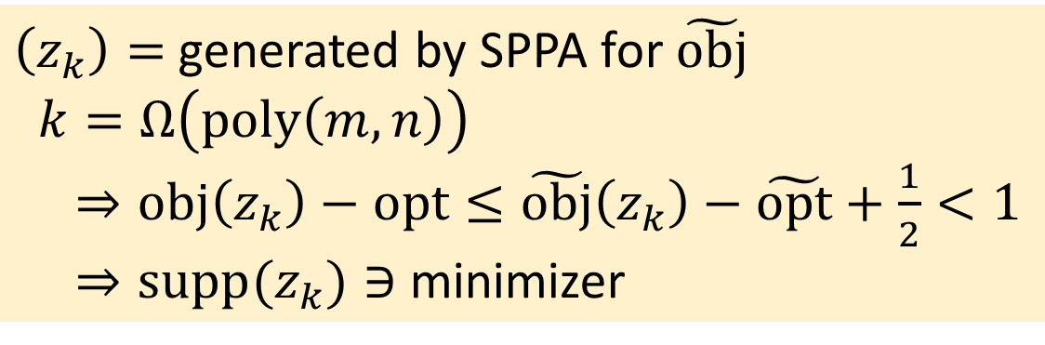
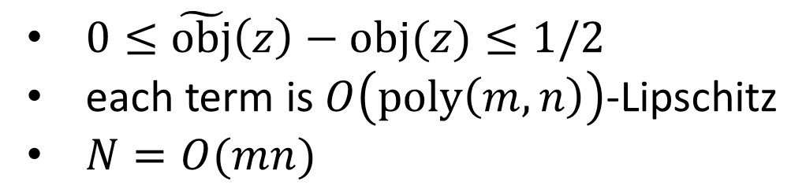

Apply SPPA to perturbed objective
$\sum_{α}{− \overline{\text{dim}}}\left(x_{α}\right)+ε{d(0, x_{α})}^{2}$
$+\sum_{β}{−\overline{\text{dim}}\text{(}y_{β})}+ε{d(0, y_{β})}^{2}$
$+ \sum_{α,β}{M\overline{R_{αβ}}(x_{α},y_{β})}$
ensure
$ε$-strong-convexity
$$ε^{−1}=O(n+m)$$
$$z=(x_{1},x_{2},…,x_{μ},y_{1},y_{2},…,y_{ν})$$
$0≤\tilde{\text{obj}}\left(z\right)−\text{obj}(z)≤1/2$
each term is $O\left(\text{poly}\left(m,n\right)\right)$-Lipschitz
$N=O(mn)$
$\left(z_{k}\right)=$generated by SPPA for $\tilde{\text{obj}}$
$k=Ω\left(\text{poly}\left(m,n\right)\right)$
$⇒\text{obj}\left(z_{k}\right)−opt≤\tilde{\text{obj}}\left(z_{k}\right)−\tilde{\text{opt}}+\frac{1}{2}<1$
$⇒\text{supp}(z_{k})∋$ minimizer

Slide 22
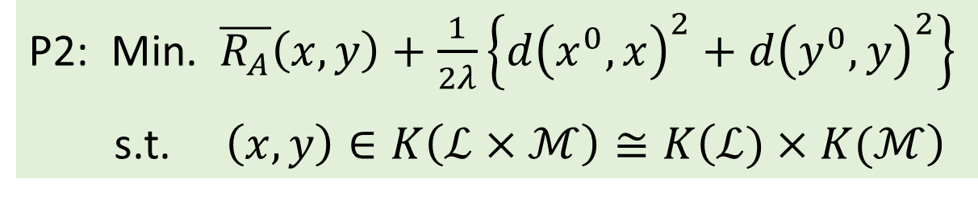
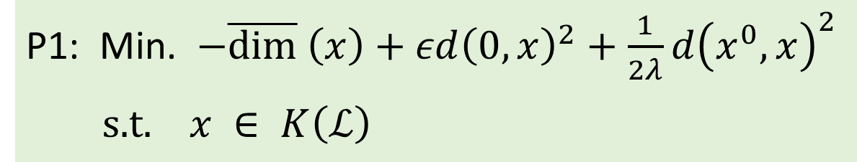
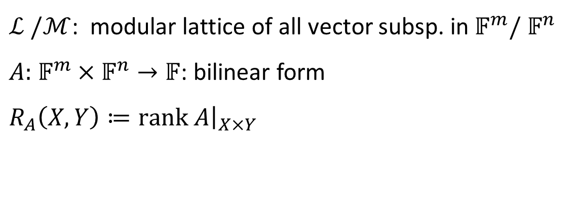
In each iteration of SPPA, we need to solve:
P1: Min. $−\overline{\text{dim}} \left(x\right)+εd{\left(0,x\right)}^{2}+\frac{1}{2λ}d{\left(x^{0},x\right)}^{2}$
$\text{s}\text{.}\text{t}\text{. }x ∈ K\left(ℒ\right)$
P2: Min. $\overline{R_{A}}\left(x,y\right)+\frac{1}{2λ}\left\{d{\left(x^{0},x\right)}^{2}+d{\left(y^{0},y\right)}^{2}\right\}$
s.t. $\left(x,y\right)∈K\left(ℒ×ℳ\right)≅K\left(ℒ)×K(ℳ\right)$
rev. inclusion
$ℒ /ℳ$: modular lattice of all vector subsp. in$𝔽^{m}/ 𝔽^{n}$
$A:$ $𝔽^{m}×𝔽^{n}→𝔽$: bilinear form
$R_{A}\left(X,Y\right)≔\text{rank} A{\left.​\right|}_{X×Y}$
P1 and P2
are solvable in
polynomial time

Slide 23




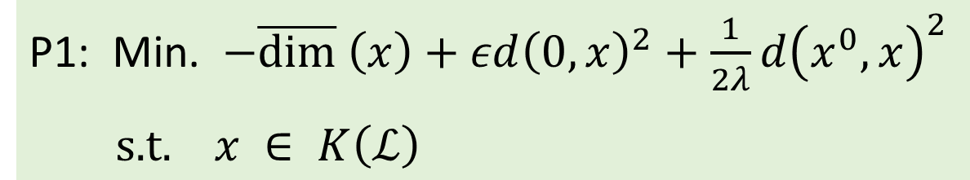

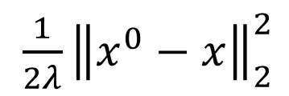



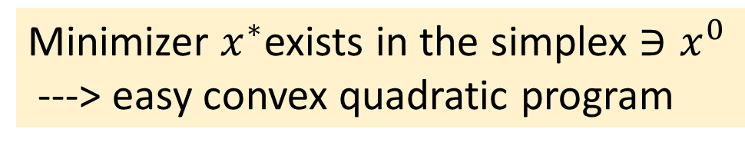
$\frac{1}{2λ}{\left\|x^{0}−x\right\|}_{2}^{2}$
$$−{\left\|x\right\|}_{1}$$
$$ε{\left\|x\right\|}_{2}^{2}$$
P1: Min. $−\overline{\text{dim}} \left(x\right)+εd{\left(0,x\right)}^{2}+\frac{1}{2λ}d{\left(x^{0},x\right)}^{2}$
$\text{s}\text{.}\text{t}\text{. }x ∈ K\left(ℒ\right)$
$$p_{3}$$
$x^{0}=\sum_{i}{λ_{i}p_{i}}$
$$x^{∗}$$
$$p_{2}$$
$$p_{0}$$
$$p_{1}$$
Minimizer $x^{∗}$exists in the simplex $∋x^{0}$
---> easy convex quadratic program

Slide 24
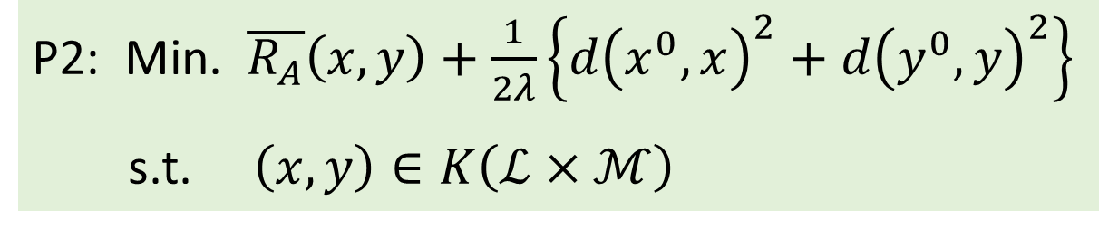





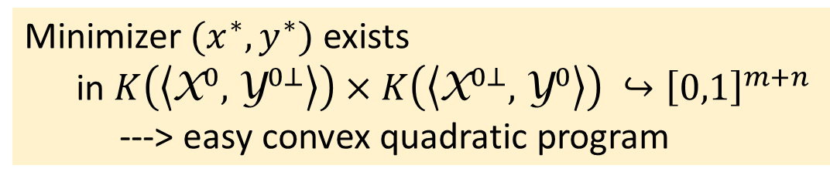

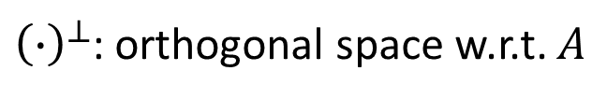
P2: Min. $\overline{R_{A}}\left(x,y\right)+\frac{1}{2λ}\left\{d{\left(x^{0},x\right)}^{2}+d{\left(y^{0},y\right)}^{2}\right\}$
s.t. $\left(x,y\right)∈K\left(ℒ×ℳ\right)$
$$ℒ$$
$$ℳ$$
$${\text{X}}^{0}$$
$${\text{Y}}^{0⊥}$$
$${\text{X}}^{0⊥}$$
$${\text{Y}}^{0}$$
${\left(∙\right)}^{⊥}$: orthogonal space w.r.t. $A$
distributive lattice
Minimizer$(x^{∗},y^{∗})$ exists
in $K\left(\left\langle {\text{X}}^{0},{\text{Y}}^{0⊥}\right\rangle \right)×K\left(\left\langle {\text{X}}^{0⊥},{\text{Y}}^{0}\right\rangle \right) ↪{\left[0,1\right]}^{m+n}$
---> easy convex quadratic program

Slide 25

Concluding remarks
Weighted-MVSP: Max. $\sum_{α}{C_{α}\text{dim}}$ $X_{α}+ \sum_{β}{D_{β}\text{dim} Y_{β}}$
is solvable in pseudo-polynomial time
Quasi DM-decomposition
$⟺$ a chain of max. vanishing subsp. detectable by WMVSP
Duality theory + better algorithm for MVSP ?
Vector-space generalization of other problems ?
CAT(0)-space relaxation ---> new paradigm
in combinatorial optimization ?

Slide 26
Thank you for your attention!
M. Hamada and H. Hirai:
Maximum vanishing subspace problem, CAT(0)-space relaxation, and block-triangularization of partitioned matrix, 2017, arXiv.

