Slide 1
Computing degree of determinant via
discrete convex optimization
over Euclidean building
Hiroshi Hirai
University of Tokyo
hirai@mist.i.u-tokyo.ac.jp
Workshop: Recent Development in Optimization 2
GRIPS, Roppongi, Tokyo, 2018/10/13

Slide 2
Contents
non-commutative
combinatorial optimization v.s. linear algebra
Submodularity + Discrete convexity
Background: Edmonds problem and recent development
Motivation + contribution of this work

Slide 3
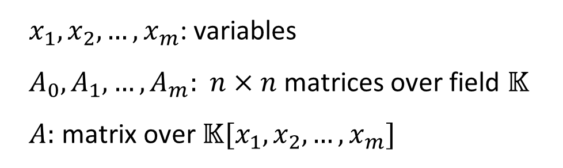
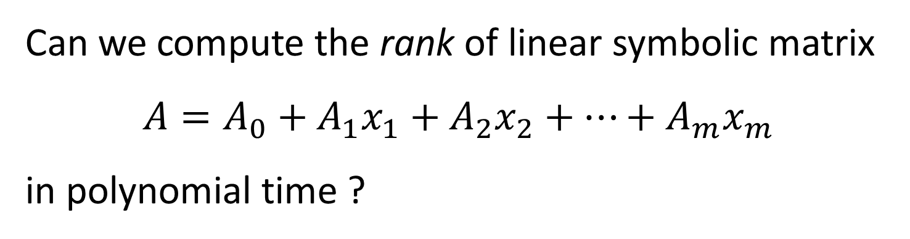


Edmonds Problem
Edmonds 1967
Can we compute the rank of linear symbolic matrix
$$A=A_{0}+A_{1}x_{1}+A_{2}x_{2}+…+A_{m}x_{m}$$
in polynomial time ?
$x_{1},x_{2},…,x_{m}$: variables
$A_{0},A_{1},…,A_{m}:$ $n×n$ matrices over field $𝕂$
$A:$ matrix over $𝕂[x_{1},x_{2},…,x_{m}]$
$$↪$$
$$𝕂(x_{1},x_{2},…,x_{m})$$

Slide 4

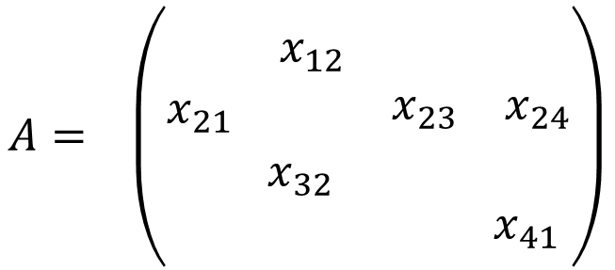
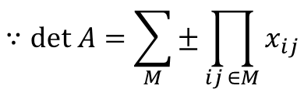
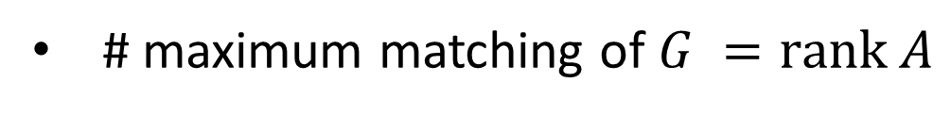
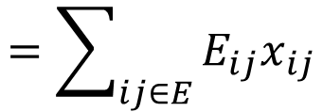
Motivation
Algebraic Interpretation of Bipartite Matching
1
1
1
2
3
4
$$A= \left(\begin{matrix}\begin{matrix} & x_{12} \\ x_{21} & \end{matrix} & \begin{matrix} & \\ x_{23} & x_{24}\end{matrix} \\ \begin{matrix} & x_{32} \\ & \end{matrix} & \begin{matrix} & \\ & x_{41}\end{matrix}\end{matrix}\right)$$
1
2
2
2
3
3
3
4
4
4
$$G=(U,V;E)$$
$$=\sum_{ij∈E}{E_{ij}x_{ij}}$$
# maximum matching of $G =\text{rank} A$
$$∵\text{det} A=\sum_{M}{±\prod_{ij ∈M}{x_{ij}}}$$
min-max formula ( König-Egerváry )
polynomial time algorithm

Slide 5
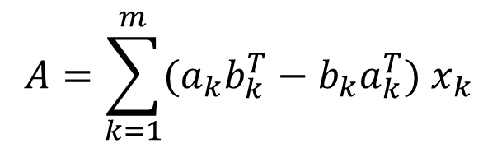
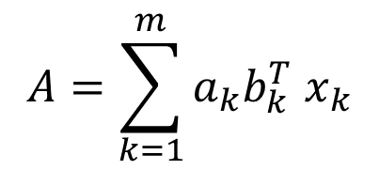

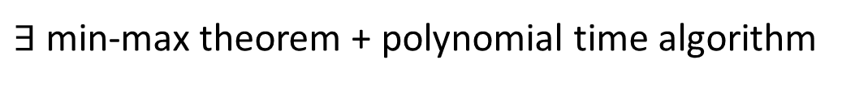
$$A=\sum_{k=1}^{m}{a_{k}b_{k}^{T} x_{k}}$$
Linear matroid intersection -----
$$A=\sum_{k=1}^{m}{{(a}_{k}b_{k}^{T}}−b_{k}a_{k}^{T}) x_{k}$$
Linear matroid matching -----
$∃$ min-max theorem + polynomial time algorithm
Edmonds 1970, Lovász 1981
Open：Deterministic polynomial time rank computation
of general $A=A_{0}+\sum_{k=1}^{m}{A_{k}x_{k}}$
Randomized polynomial time algorithm (Lovász 1979)
Connection to circuit complexity (Kabanets-Impagliazzo 2004)

Slide 6

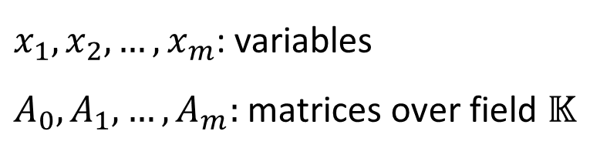

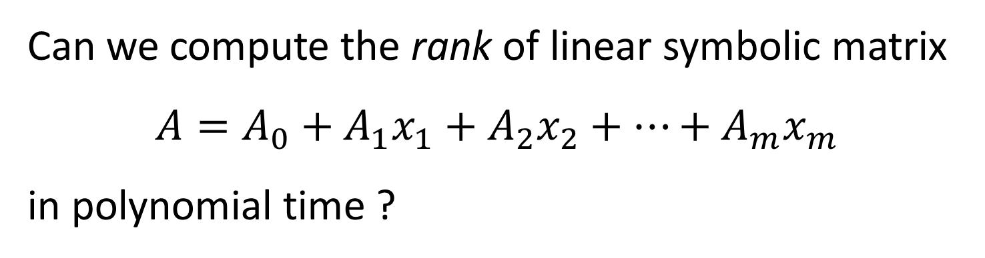
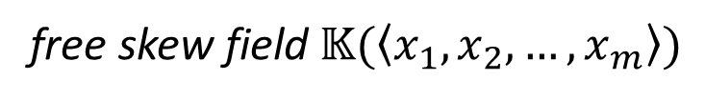
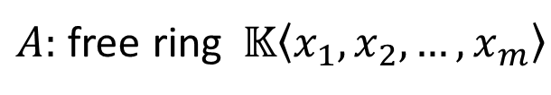

Non-commutative
Edmonds Problem
nc-
Ivanyos-Qiao-Subrahmanyam 2015
Can we compute the rank of linear symbolic matrix
$$A=A_{0}+A_{1}x_{1}+A_{2}x_{2}+…+A_{m}x_{m}$$
in polynomial time ?
$x_{1},x_{2},…,x_{m}$: variables
$A_{0},A_{1},…,A_{m}:$ matrices over field $𝕂$
$$x_{i}x_{j}≠x_{j}x_{i}$$
nc-rank
$$≤$$
rank
$A:$ free ring $𝕂\left\langle x_{1},x_{2},…,x_{m}\right\rangle$
$$↪$$
Amitsur 1966
free skew field$𝕂(\left\langle x_{1},x_{2},…,x_{m}\right\rangle )$

Slide 7

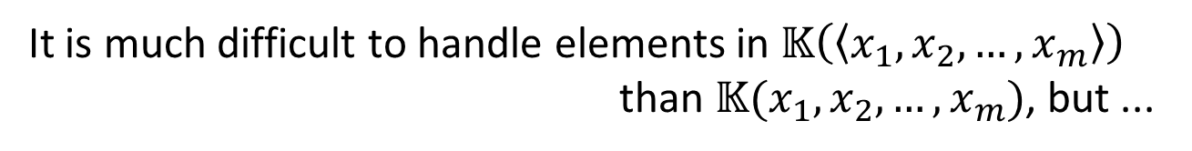


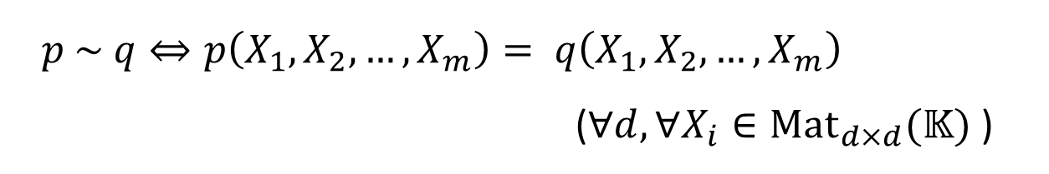
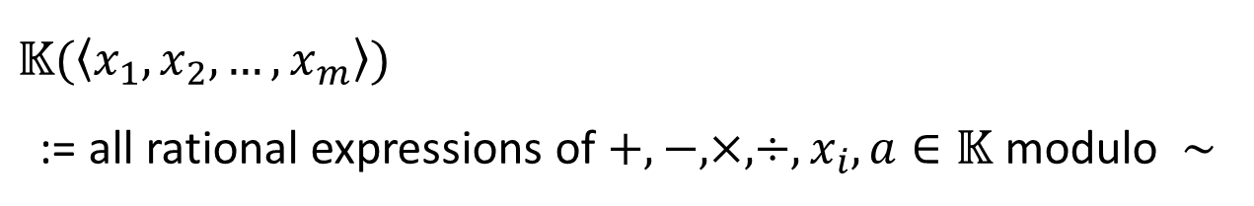
What is free skew field $𝕂(\left\langle x_{1},x_{2},…,x_{m}\right\rangle )$?
skew field = ring s.t. $∀$nonzero element has inverse
$𝕂(\left\langle x_{1},x_{2},…,x_{m}\right\rangle )$
:= all rational expressions of $+,−,×,÷,x_{i}, a∈𝕂$ modulo $\sim$
$$∋$$
$$p={\left(x_{2}x_{1}x_{2}^{−1}+x_{3}−3\right)}^{−1}$$
$p \sim q⇔p\left(X_{1},X_{2},…,X_{m}\right)= q\left(X_{1},X_{2},…,X_{m}\right)$
($∀d, ∀X_{i}∈\text{Ma}{\text{t}}_{d×d}(𝕂)$ )
It is much difficult to handle elements in $𝕂\left(\left\langle x_{1},x_{2},…,x_{m}\right\rangle \right)$
than $𝕂(x_{1},x_{2},…,x_{m})$, but ...

Slide 8


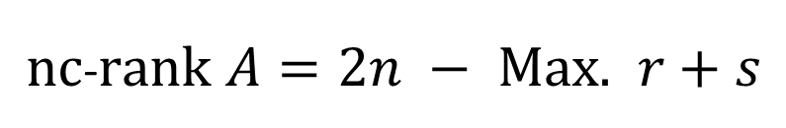


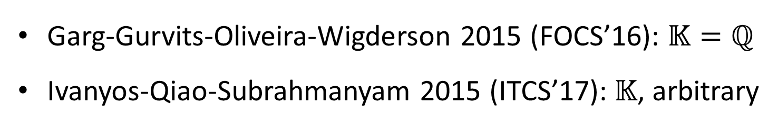


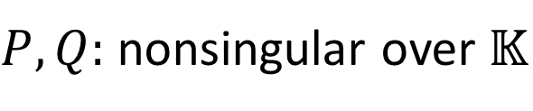



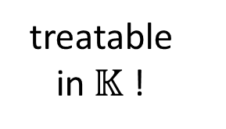
nc-rank in P !!
Garg-Gurvits-Oliveira-Wigderson 2015 (FOCS’16): $𝕂=ℚ$
Ivanyos-Qiao-Subrahmanyam 2015 (ITCS’17):$𝕂$, arbitrary
Min-max theorem: Fortin-Reutenauer 2004
treatable
in$𝕂$ !
$\text{nc}$-$rank A=2n − \text{Max}\text{. }r+s$
s.t.
$$PA_{i}Q=$$
$$∗$$
$$∗$$
rank = nc-rank
$$∗$$
$$(∀i)$$
$$r$$
$$0$$
bipartite matching
linear matroid intersection
$$∗$$
min-max theorem
$$s$$
rank < nc-rank
$P,Q:$ nonsingular over $𝕂$
non-bipartite matching
linear matroid matching

Slide 9






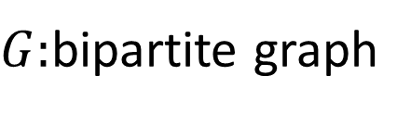
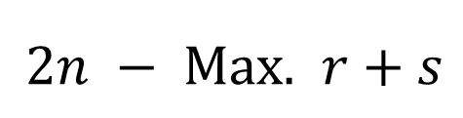







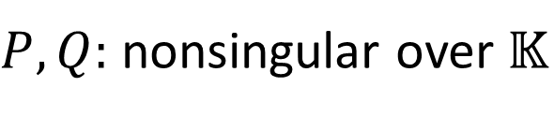


König-Egerváry from Fortin-Reutenauer
$G:$bipartite graph
$2n − \text{Max}\text{. }r+s$
$$j$$
$$∗$$
$$∗$$
s.t.
$$P$$
$$Q=$$
$$∗$$
$$r$$
$$(∀e=ij∈E)$$
$$i$$
$$1$$
$$0$$
$$∗$$
$$s$$
permutation matrices
$P,Q:$ nonsingular over $𝕂$
$$=2n−\text{\#}\text{maximum} \text{stable} \text{set}$$
$$=\text{\# }\text{minimun} \text{vertex} \text{cover}$$

Slide 10
Algorithms for nc-rank
Garg-Gurvits-Oliveira-Wigderson 2015 (FOCS’16):
Gurvits’ operator scaling
Ivanyos-Qiao-Subrahmanyam 2015 (ITCS’17):
Wong sequence --- vector-space analogue of augmenting path
Hamada-Hirai 2017:
Submodularity + convex optimization on CAT(0)-space
They are beyond Euclidean convex optimization

Slide 11


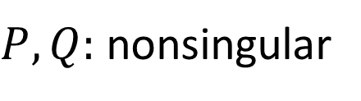
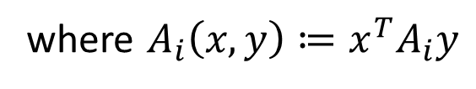

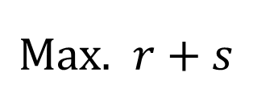











Submodularity View
Hamada-Hirai 2017
$$\text{M}\text{ax}\text{.} r+s$$
$$∗$$
$$∗$$
s.t.
$$PA_{i}Q=$$
$$∗$$
$$(∀i)$$
$$r$$
$$0$$
$$∗$$
$$s$$
$P,Q:$ nonsingular
Submodular optimization
on the modular lattice
of vector subspaces
$$=$$
$$\text{Max}\text{. } \text{dim} X+ \text{dim} Y$$
$$s. t. A_{i}\left(X,Y\right)=0$$
$$\left(∀i\right)$$
$$X,Y⊆𝕂^{n}$$
vector subspaces
where $A_{i}\left(x,y\right)≔x^{T}A_{i}y$

Slide 12

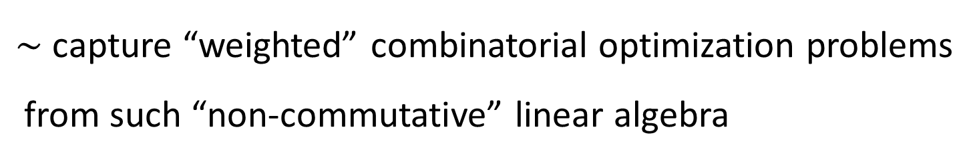
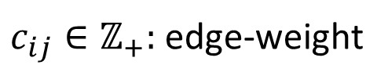
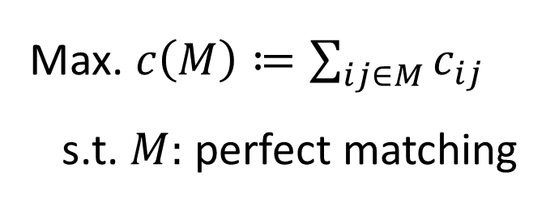

Motivation of this work
$\sim$ capture “weighted” combinatorial optimization problems
from such “non-commutative” linear algebra
Ex: Weighted bipartite matching
1
$$c_{12}$$
1
2
2
$c_{ij}∈ℤ_{+}:$ edge-weight
3
3
4
$$c_{43}$$
4
Max. $c\left(M\right)≔\sum_{ij∈M}{c_{ij}}$
s.t. $M:$ perfect matching

Slide 13

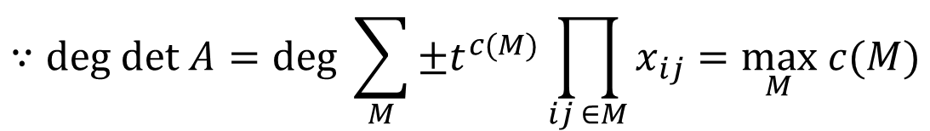

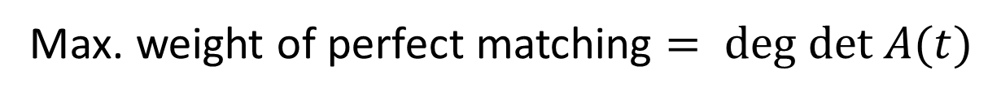

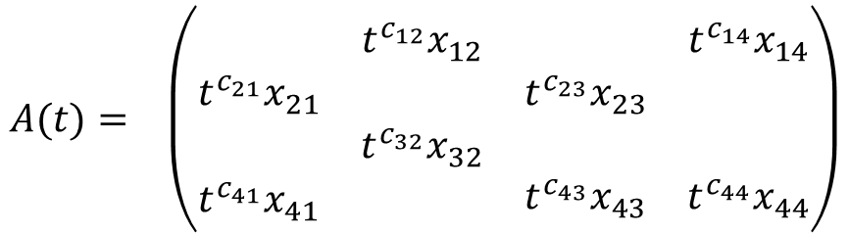
Algebraic Interpretation of Weighted Matching
1
$$c_{12}$$
1
1
2
3
4
$$A(t)= \left(\begin{matrix}\begin{matrix} & t^{c_{12}}x_{12} \\ {t^{c_{21}}x}_{21} & \end{matrix} & \begin{matrix} & t^{c_{14}}x_{14} \\ {t^{c_{23}}x}_{23} & \end{matrix} \\ \begin{matrix} & {t^{c_{32}}x}_{32} \\ t^{c_{41}}x_{41} & \end{matrix} & \begin{matrix} & \\ t^{c_{43}}x_{43} & t^{c_{44}}x_{44}\end{matrix}\end{matrix}\right)$$
1
2
2
2
3
3
3
4
$$c_{43}$$
4
4
$$=\sum_{ij∈E}{t^{c_{ij}}E_{ij}x_{ij}}$$
Max. weight of perfect matching $= \text{deg} \text{det} A(t)$
$$∵\text{deg} \text{det} A=deg \sum_{M}{±t^{c(M)}\prod_{ij ∈M}{x_{ij}}}=\max_{M} c(M)$$

Slide 14
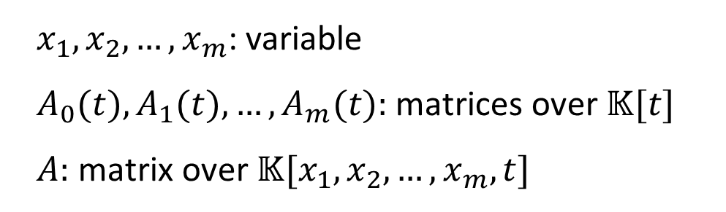
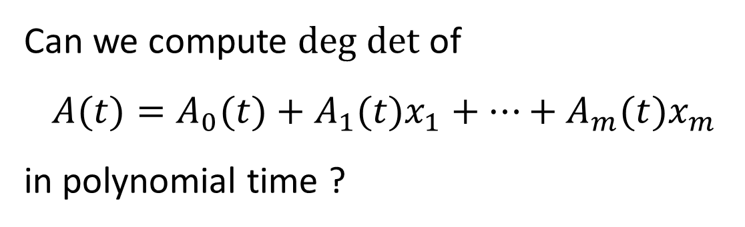
Weighted Edmonds Problem
Can we compute $\text{deg} \text{det}$ of
$$A(t)=A_{0}(t)+A_{1}(t)x_{1}+…+A_{m}(t)x_{m}$$
in polynomial time ?
$x_{1},x_{2},…,x_{m}$: variable
$A_{0}(t),A_{1}(t),…,A_{m}(t):$ matrices over $𝕂[t]$
$A:$ matrix over $𝕂[x_{1},x_{2},…,x_{m},t]$
Goal: develop a non-commutative version

Slide 15
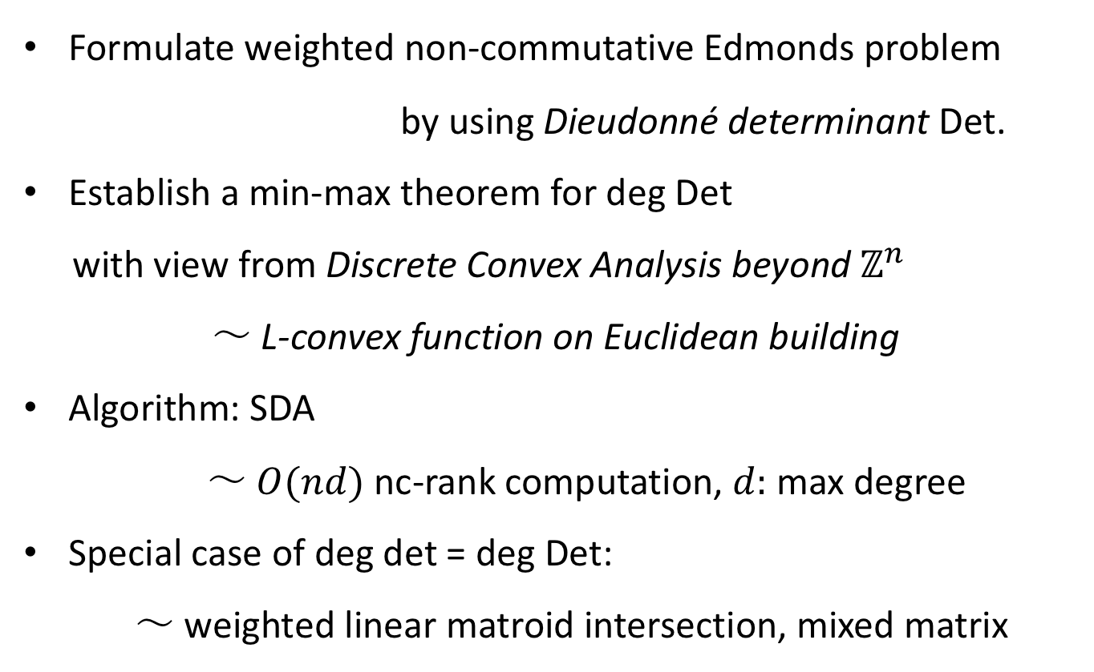
Contribution
Formulate weighted non-commutative Edmonds problem
by using Dieudonné determinant Det.
Establish a min-max theorem for deg Det
with view from Discrete Convex Analysis beyond $ℤ^{n}$
～ L-convex function on Euclidean building
Algorithm: SDA
～ $O(nd)$ nc-rank computation, $d:$ max degree
Special case of deg det = deg Det:
～ weighted linear matroid intersection, mixed matrix

Slide 16

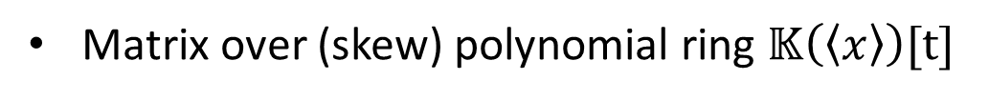
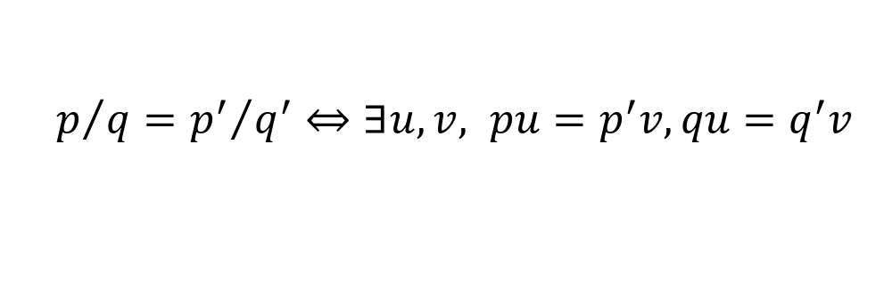
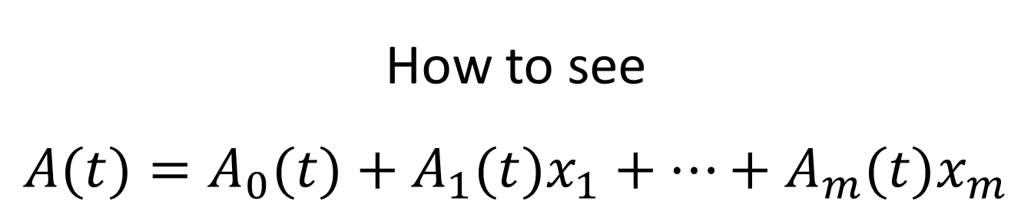
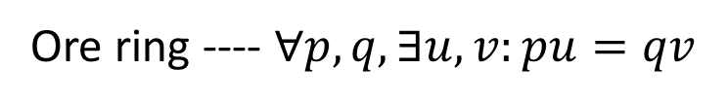
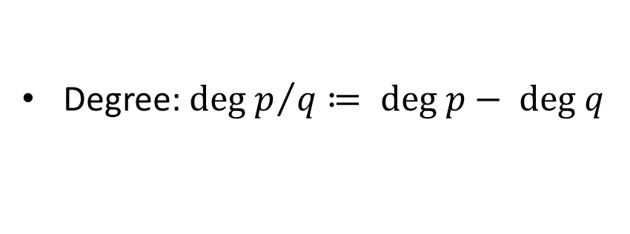

How to see
$$A(t)=A_{0}(t)+A_{1}(t)x_{1}+…+A_{m}(t)x_{m}$$
Matrix over (skew) polynomial ring $𝕂\left(\left\langle x\right\rangle \right)[t]$
Ore ring ---- $∀p,q,∃u,v:pu=qv$
$$≠0$$
Matrix over Ore quotient ring $𝕂\left(\left\langle x\right\rangle \right)(t)$
$p/q={p^{′}}/{q^{′}}⇔∃u,v, pu=p^{′}v,qu=q^{′}v$
$$≠0$$
Degree: ${\text{deg} p}/q≔ \text{deg} p− \text{deg} q$

Slide 17
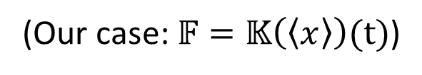
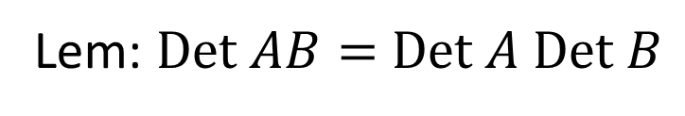
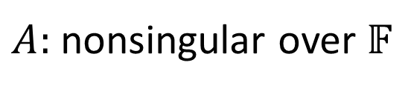
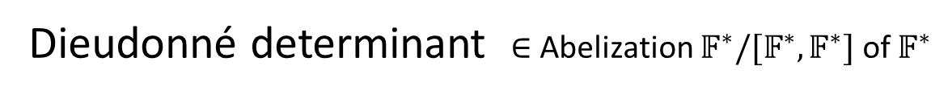
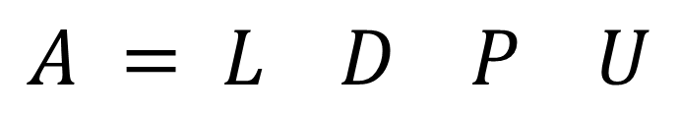
How to define “determinant”
of matrices over skew field
$A:$ nonsingular over $𝔽$
(Our case:$𝔽=𝕂\left(\left\langle x\right\rangle \right)(t)$)
Bruhat decomposition: LU-decomposition of matrices over skew field
uni-lower-triangular
uni-upper-triangular
$$A = L D P U$$
diagonal
permutation
unique
Dieudonné determinant $∈$ Abelization $𝔽^{∗}/[𝔽^{∗},𝔽^{∗}]$ of $𝔽^{∗}$
$$\text{Det} A≔ \text{sgn}\left(P\right)D_{11}D_{22}…D_{nn} \text{mod} [𝔽^{∗},𝔽^{∗}]$$
commutator group
Lem: $\text{Det} AB=$ $\text{Det} A \text{Det} B$

Slide 18
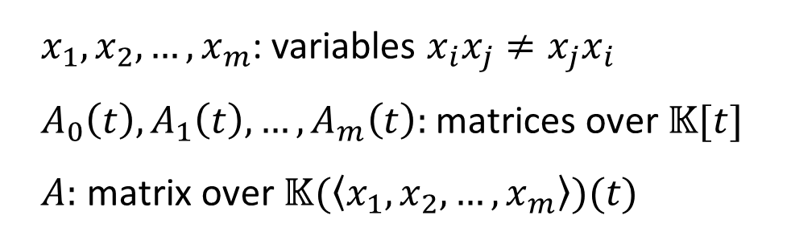
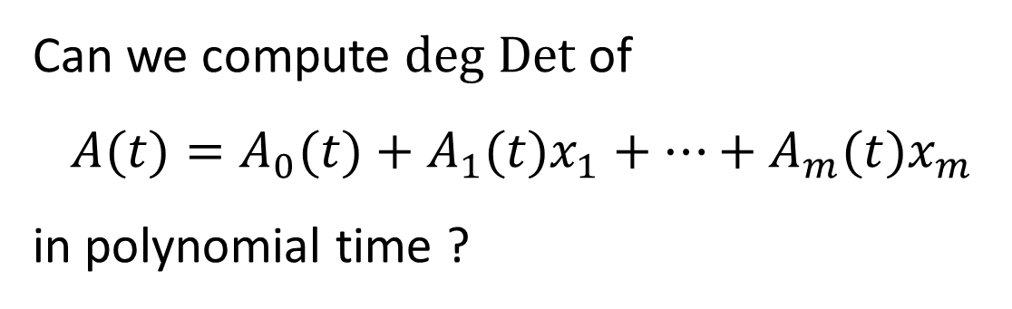

Weighted Non-commutative Edmonds Problem
Can we compute $\text{deg} \text{Det}$ of
$$A(t)=A_{0}(t)+A_{1}(t)x_{1}+…+A_{m}(t)x_{m}$$
in polynomial time ?
$x_{1},x_{2},…,x_{m}$: variables $x_{i}x_{j}≠x_{j}x_{i}$
$A_{0}\left(t\right),A_{1}\left(t\right),…,A_{m}\left(t\right):$ matrices over $𝕂[t]$
$A:$ matrix over $𝕂(\left\langle x_{1},x_{2},…,x_{m}\right\rangle )(t)$
※ $\text{deg} \text{Det}$ is well-defined since $\text{deg}$ is zero on commutators
$$\text{deg}\text{ (}pqp^{−1}q^{−1})=0$$

Slide 19

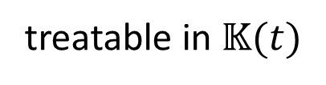


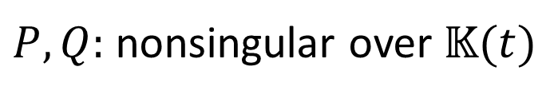
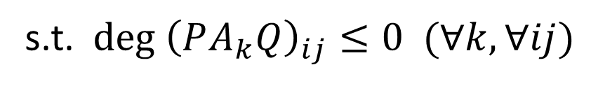
Min-Max Theorem
treatable in $𝕂(t)$
$$A=A_{0}+A_{1}x_{1}+…+A_{m}x_{m}$$
$$\text{deg} \text{Det} A=$$
$$\text{Min}\text{. −}\text{deg} \text{det} P − \text{deg} \text{det} \text{Q}$$
s.t. $\text{deg} {\left(PA_{k}Q\right)}_{ij}≤0 (∀k,∀ij)$
$P,Q:$ nonsingular over $𝕂(t)$

Slide 20









Weak Duality
$$\text{deg} {\left(PA_{k}Q\right)}_{ij}≤0 (∀k,∀ij)$$
$$⇒\text{deg} {\left(PAQ\right)}_{ij}≤0 (∀ij)$$
$$⇒\text{deg} \text{Det} PAQ≤0$$
$$⇒\text{deg} (\text{Det} P \text{Det} A \text{Det} Q)≤0$$
$$⇒\text{deg} \text{Det} P \text{+ }\text{deg} \text{Det} A+deg \text{Det} Q≤0$$
$⇒\text{deg} \text{Det} A≤− \text{deg} \text{Det} P \text{−}$ $deg \text{Det} Q$
$$=$$
$$=$$
$$\text{deg} \text{d}\text{et} P$$
$$\text{deg} \text{d}\text{et} Q$$

Slide 21








Strong Duality + Algorithm (SDA)
$PAQ=$ ${\left(PAQ\right)}^{0}+O(t^{−1})$
$$=$$
$${\left(PA_{0}Q\right)}^{0}+{\left(PA_{1}Q\right)}^{0}x_{1}+…+{\left(PA_{m}Q\right)}^{0}x_{m}$$
over $𝕂(\left\langle x\right\rangle )$
over $𝕂$
${\left(PAQ\right)}^{0}:$ nonsingular on $𝕂(\left\langle x\right\rangle )⇒$
$$\text{deg} \text{Det} PAQ=0$$
$⇒ \text{deg} \text{Det} A=−\text{deg} \text{det} P−\text{deg} \text{det} Q$ $⇒ P,Q:$optimal
${\left(PAQ\right)}^{0}:$ singular on $𝕂(\left\langle x\right\rangle )$ $⇒$
We can augment $P,Q→P^{′},Q′$ s.t.
$$\text{deg} \text{det} P^{′}+\text{deg} \text{det} Q^{′}>\text{deg} \text{det} P+\text{deg} \text{det} Q$$

Slide 22






















${\left(PAQ\right)}^{0}:$ singular on $𝕂(\left\langle x\right\rangle )$ $⇒$
nc-rank of ${\left(PAQ\right)}^{0}<n$
$$t^{−1}$$
$$t^{−1}$$
$$∗$$
$$∗$$
$$∗$$
$∃S,T:$ nonsingular
over $𝕂$
$SPAQT=$ $+O(t^{−1})$
$$∗$$
$$t$$
$$0$$
$$r$$
$$t$$
$$t$$
$$s$$
$$r+s>n$$
$\left(\begin{matrix}I & O \\ O & tI_{r}\end{matrix}\right)SPAQT\left(\begin{matrix}I & O \\ O & t^{−1}I_{n−s}\end{matrix}\right)$ $⇒$ $\text{deg} {\left(P^{′}AQ^{′}\right)}_{ij}≤0$
$$P′$$
$$Q′$$
$$\text{deg} \text{det} P^{′}+\text{deg} \text{det} Q^{′}=(r+s−n)+\text{deg} \text{det} P+\text{deg} \text{det} Q$$
$$>0$$
Long-step: use $\left(\begin{matrix}I & O \\ O & t^{α}I_{r}\end{matrix}\right)$, $\left(\begin{matrix}I & O \\ O & {t^{−α}I}_{n−s}\end{matrix}\right)$, $α>0$

Slide 23



Remarks
Essence of this argument / algorithm is
in combinatorial relaxation method (Murota 1990,1995)
developed for computing $\text{deg} \text{det}$.
short-step
Naive iteration bound for initial $\left(P,Q\right)=(t^{−d}I,I)$
$nd$ ($d:$ maximum degree)
We can improve this bound to
$d−(\text{deg} \text{Det} A−\text{max} \text{deg} (n−1$-minor$))$
= max deg – min deg of Smith-McMillan form of $A$
from view of discrete convex analysis beyond $ℤ^{n}$

Slide 24




Special case of $\text{deg} \text{det}\text{ = }\text{deg} \text{Det}$
$$A=A_{0}+A_{1}x_{1}+A_{2}x_{2}+…+A_{m}x_{m}$$
Thm [Ivanyos et al 2010]
$\text{rank} A_{i}=1 (∀i ≥1)⟹$ $\text{rank} A=\text{nc}$-$\text{rank} \text{A}$.
bipartite matching --- $\sum_{ij∈E}{{E_{ij}x}_{ij}}$
linear matroid intersection --- $\sum_{k}{{a_{k}b_{k}^{T}x}_{k}}$
mixed matrix (Murota-Iri 1985) --- $A_{0}+$ $\sum_{ij∈E}{{E_{ij}x}_{ij}}$
$$A(t)=A_{0}(t)+A_{1}(t)x_{1}+…+A_{m}(t)x_{m}$$
Thm [H. 18]
$\text{rank} A_{i}(t)=1 (∀i ≥1)⟹$ $\text{d}\text{eg} \text{det} A=\text{deg} \text{Det} \text{A}$.
mixed polynomial matrix
weighted ver.

Slide 25








bipartite matching $\sum_{ij∈E}{t^{c_{ij}}{E_{ij}x}_{ij}}$
SDA + long-step $≈$ Hungarian
Interpretation
via
Euclidean building
Linear matroid $\sum_{k}{t^{c_{k}}{a_{k}a_{k}^{T}x}_{k}}$
SDA + long-step $≈$ Greedy
Linear matroid intersection $\sum_{k}{{t^{c_{k}}a_{k}b_{k}^{T}x}_{k}}$
?
SDA + long-step $≈$ Lawler’s primal dual
Lawler 1975
Mixed polynomial matrix ${ A}_{0}\left(t\right)+\sum_{ij∈E}{t^{c_{ij}}{E_{ij}x}_{ij}}$
SDA + optimization over $ℤ^{n}$-sublattice (apartment)
$≈$ combinatorial relaxation algo.
Iwata-Takamatsu 2013
Iwata-Oki-Takamatsu 2017
dual of bipartite matching

Slide 26






















View from Discrete Convex Analysis beyond $ℤ^{n}$
Dual of nc-rank
Dual of deg Det
$$\text{M}\text{ax}\text{.} r+s$$
$$\text{Max}\text{. }\text{deg} \text{det} P + \text{deg} \text{det} \text{Q}$$
$$∗$$
$$∗$$
s.t.
$$PA_{k}Q=$$
$$∗$$
$$(∀k)$$
s.t. $\text{deg} {\left(PA_{k}Q\right)}_{ij}≤0 (∀k,∀ij)$
$$r$$
$$0$$
$$∗$$
$$s$$
$P,Q:$ nonsingular over $𝕂(t)$
$P,Q:$ nonsingular over $𝕂$
$$=$$
L-convex optimization
on the modular lattice
of free modules over PID $𝕂{\left(t\right)}^{−}$
$$\text{Max}\text{. } \text{dim} X+ \text{dim} Y$$
$$\left(∀k\right)$$
$$s. t. A_{k}\left(X,Y\right)=0$$
$$X,Y⊆𝕂^{n}$$
vector subspaces
Submodular optimization
on the modular lattice
of vector subspaces
where $A_{k}\left(x,y\right)≔x^{T}A_{k}y$

Slide 27









$$\text{Max}\text{. }\text{deg} \text{det} P + \text{deg} \text{det} \text{Q}$$
s.t. $\text{deg} {\left(PA_{k}Q\right)}_{ij}≤0 (∀k,∀ij)$
$P,Q:$ nonsingular over $𝕂(t)$
$$𝕂{\left(t\right)}^{−}≔\left\{{ p}/q∈𝕂\left(t\right)\right|{\text{deg} p}/q≤0\}$$
${\left\langle P\right\rangle }_{𝕂{\left(t\right)}^{−}}$ $⟷$ full-rank free$𝕂{\left(t\right)}^{−}$-submodule of $𝕂{\left(t\right)}^{n}$
$$=$$
$$\text{Max}\text{. }\text{deg} L + \text{deg} M$$
s.t. $\text{deg} A_{k}\left(L,M\right)⊆[−∞,0] (∀k)$
$L,M:$ full-rank free$𝕂{\left(t\right)}^{−}$-submodules of $𝕂{\left(t\right)}^{n}$
where $A_{k}\left(x,y\right)≔x^{T}A_{k}y$

Slide 28




$ℒ_{𝕂{\left(t\right)}^{n}}≔\{$ full-rank free$𝕂{\left(t\right)}^{−}$-submodules of $𝕂{\left(t\right)}^{n} \}$
$≈$ Euclidean building of $\text{SL}\text{(}𝕂{\left(t\right)}^{n}\text{)}$
Lem: $ℒ_{𝕂{\left(t\right)}^{n}}$ is a uniform modular lattice, i.e.,
$x⟼{\left(x\right)}^{+}≔ \bigvee{\left\{y \right| y \text{covers} x\}}$
is order-preserving bijection
Rem [H. 17] : uniform modular lattice
$≈$ Euclidean building of type A

Slide 29





Uniform modular lattice [H.17]
$x⟼{\left(x\right)}^{+}≔ \bigvee{\left\{y \right| y \text{covers} x\}}$ is order-preserving bijection
Ex: $ℤ^{n}$, $∧$ = min, $∨$ = max, ${\left(x\right)}^{+}=x+1$
Ex: $ℤ⊠$ $Tree$
$${\left(x\right)}^{+}$$
$$x$$
Rem: $ℒ_{𝕂{\left(t\right)}^{2}}≈ ℤ⊠$ infinite regular tree

Slide 30





L-convexity on uniform modular lattice
Def [Murota 96] $f:ℤ^{n}→ℝ∪\{∞\}$ is L-convex:
$f\left(p\right)+f\left(q\right)≥f\left(p∧q\right)+f\left(p∨q\right)$
$∃α,f\left(p+1\right)=f\left(p\right)+α$
$ℒ$: uniform modular lattice
Def [H. 17] $f:ℒ→ℝ∪\{∞\}$ is L-convex:
$f\left(p\right)+f\left(q\right)≥f\left(p∧q\right)+f\left(p∨q\right)$
$∃α,f\left({\left(p\right)}^{+}\right)=f\left(p\right)+α$
Several DCA concepts/properties are naturally extended

Slide 31






$\text{deg} \text{Det} A=$
$$\text{Min}\text{. − }\text{deg} L \text{−} \text{deg} M$$
s.t. $\text{deg} A_{k}\left(L,M\right)⊆[−∞,0] (∀k)$
$$L,M∈ℒ_{𝕂{\left(t\right)}^{n}}$$
is viewed as L-convex function minimization
on uniform modular lattice
SDA = steepest descent algorithm for this L-convex function:
$p⟶p^{′}:$ minimizer over $[p,{\left(p\right)}^{+}]$
submodular optimization
# iterations = $d_{∞}(\text{initial},\text{opt})$
adapting Murota-Shioura 2014

Slide 32
Summary
Edmonds problem, rank v.s. nc-rank
Weighted Edmonds problem, deg det v.s. deg Det
  formulation, algorithm, special case of deg det = deg Det
Submodularity / discrete convexity aspect
L-convexity on uniform modular lattice (= Euclidean building)

Slide 33



Problems
If $A=A_{0}t^{c_{0}}+A_{1}t^{c_{1}}x_{1}+…+A_{m}t^{c_{m}}x_{m}$
where $A_{i}:n×n over 𝕂,$
can we compute $\text{d}\text{eg} \text{Det} \text{A}$ in time polynomial
in $n,m, and \text{log} {\text{max}}_{i}{ c}_{i}$ ?
Representable by deg det but deg det < deg Det :
Non-bipartite matching: Edmonds 1965
Matching forest: Giles 1982
Path matching: Cunningham-Geelen 1997
Linear matroid matching: Lovász 1980, Iwata-Kobayashi 2017
Can we develop a unified theory ?

Slide 34
References
H. Hirai: Uniform modular lattice and Euclidean building, 2017
H. Hirai: Uniform semimodular lattice and valuated matroid, 2018
H. Hirai: Computing degree of determinant via discrete convex optimization over Euclidean building, 2018.
Thank you for your attention

