Slide 1
A dual descent algorithm for node-capacitated multiflow problems and its applications
Hiroshi Hirai
University of Tokyo
COMP-SIGAL
Kanazawa, June 25, 2016

Slide 2
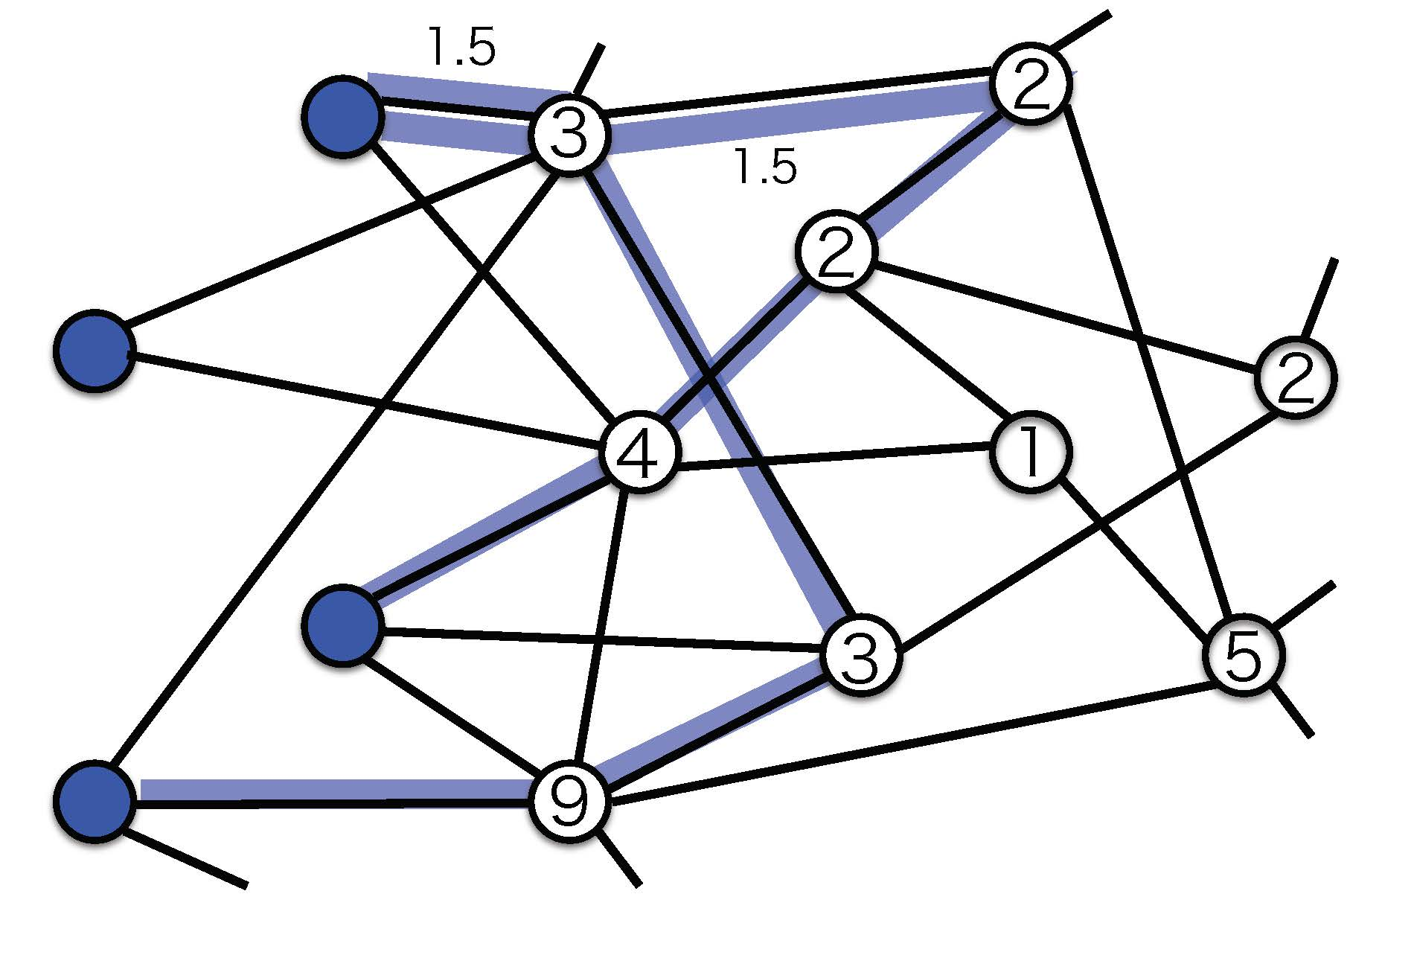
Maximum node-capacitated free multiflow
$$N=(V,E,c,T)$$
$$T$$
$$c:V−T→ℤ_{+}$$
Max. $\sum{f(P)}$
s.t. $f:\{T$-paths$\}→ℚ_{+}$
$\sum_{P:v∈P}{f\left(P\right)}≤c\left(v\right) (v∈V−T$)

Slide 3
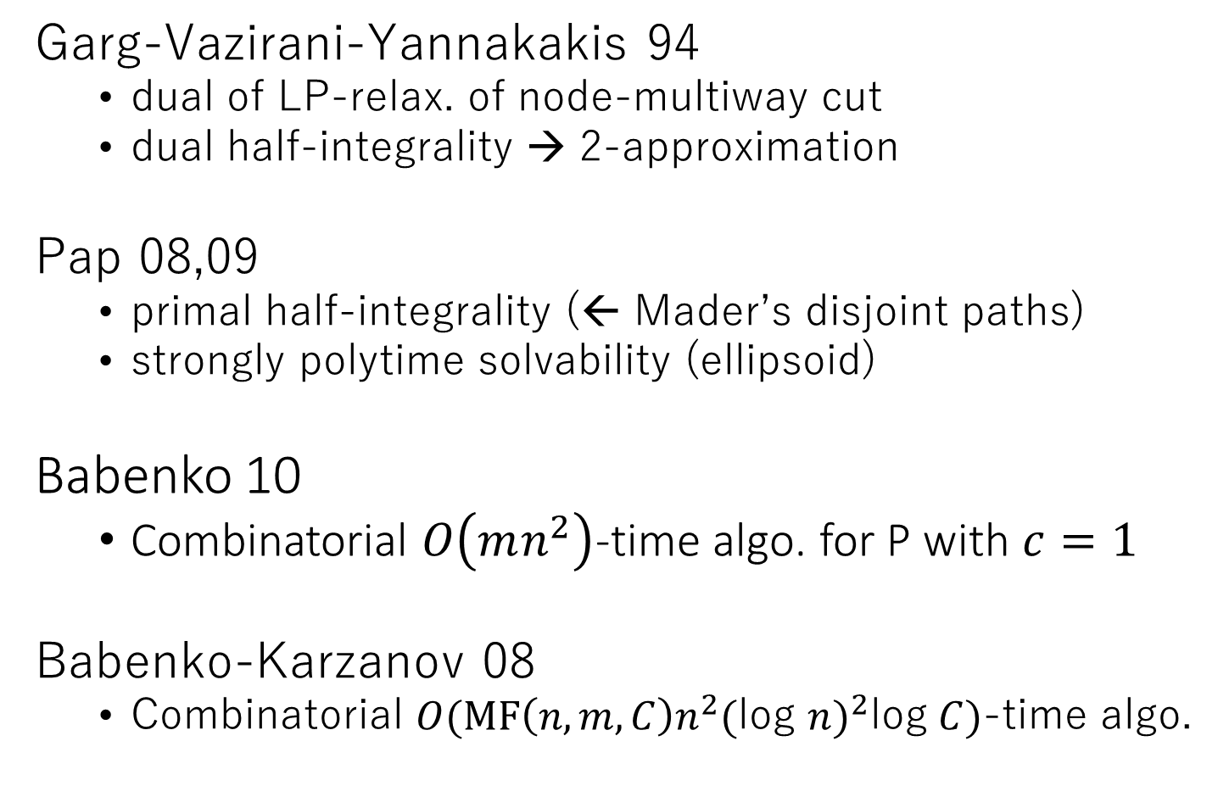
Garg-Vazirani-Yannakakis 94
dual of LP-relax. of node-multiway cut
dual half-integrality → 2-approximation
Pap 08,09
primal half-integrality (← Mader’s disjoint paths)
strongly polytime solvability (ellipsoid)
Babenko 10
Combinatorial $O\left(mn^{2}\right)$-time algo. for P with $c=1$
Babenko-Karzanov 08
Combinatorial $O(MF\left(n,m,C\right)n^{2}{(\text{log} n)}^{2}\text{log} C)$-time algo.

Slide 4
Result
Combinatorial $O(m \text{log} \left|T\right| \text{MSF}\left(n,m,1\right))$-time algo.
to find half-integral primal & dual opt.
$\text{MSF}\left(n,m,h\right)$: time of solving max. submodular flow
$h:$ time of computing exchange capacity
Fujishige-Zhang 92: $O(n^{3}h)$-time algo. for max. subflow.
--- $O(mn^{3}\text{log} \left|T\right|)$-time algo.
--- for 2-approx. of node-multiway cut
Related work:
Chekuri-Madan SODA16: $\left(2+ℰ\right)$-approx. $\tilde{O}(nm/ℰ$)-time algo.
for node-multiway cut

Slide 5
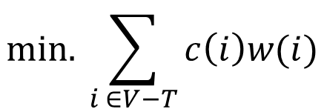
basic idea --- solve dual first, recover primal,
combinatorially
$$\text{min}\text{. }\sum_{i ∈V−T}{c\left(i\right)w(i)}$$
LP-dual:
$$\text{s}\text{.}\text{t}\text{. }\sum_{i ∈P−T}{w\left(i\right)} ≥1 (P:T\text{−}\text{path}\text{)}$$
$$w\left(i\right) ≥0 (i∈V−T)$$
( $w\left(i\right) ∈\left\{0,1\right\} →$ node-multiway cut)

Slide 6
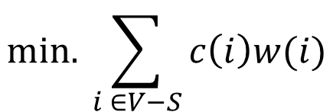
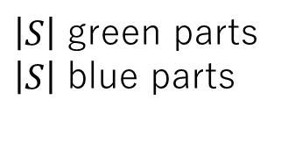
Garg-Vazirani-Yannakakis half-integrality
$$\text{min}\text{. }\sum_{i ∈V−S}{c\left(i\right)w(i)}$$
s.t. partitions of$V$:
Each edge
belongs to same part, or
connects “adjacent” parts
or “top” part
$\left|S\right|$ green parts
$\left|S\right|$ blue parts
$$w_{i}=1$$
$$w_{i}=0$$
$$s$$
Each green part
contains
exactly one terminal
$$1/2$$
$$0$$
$$t$$
Vazirani: Approximation Algorithms,
Section 19.3
$$u$$
Notes:
Again L-convex function arises from LP-dual, LP-relaxation of node-multiway cut.
Garg-Vazirani-Yannakakis showed half-integrality, which is explained as follows.
LP-dual becomes an optimization over partitions of node set V.
In this partition, there are green and blue parts corresponding to terminals.
there are one orange part and white part.
They are arranged in this way.
Now each green part must contain exactly one terminal.
Each edge must belongs the same part, or connect adjacent parts or “top” part.
Weight w on nodes is defined as follows.
If node belongs to top part, weight is one. If node belongs to blue part, the weight is one-half.
The weight of other nodes are zero.
The goal is to find such a partition with minimum objective.

Slide 7
Submodular interpretation
$$\{0,∞\}$$
$$∈$$
$$\text{Min}\text{.} g\left(x\right)≔ \sum_{i}{c(i)\text{height}(x_{i})+ \text{Constraint}(x)}$$
height
1
$$\text{s}\text{.}\text{t}\text{. }x_{i}∈$$
1/2
$(i ∈V$)
0
$$n$$
$$x⊔y$$
$$y$$
$$g:$$
$$ℚ∪\{+∞\}$$
$$x$$
$$x⊓y$$
is “submodular”
$$g\left(x\right)+g\left(y\right)≥g\left(x⊓y\right)+g(x⊔y)$$
(Y. Iwata 2013)

Slide 8
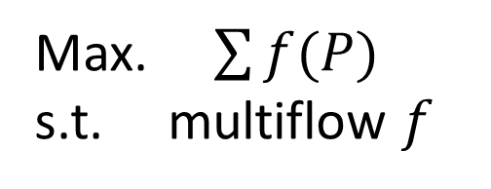
I do not know
how to solve this SFM & how to recover primal opt,
directly & combinatorially
edge-cost
perturb
Max. $\sum{f(P)}$
s.t. multiflow $f$
$\sum{μ(s_{P},t_{P})f(P)}−\sum{f(e)}$
$μ:\left(\begin{aligned}T \\ 2\end{aligned}\right)→ℤ_{+}$ trivalent tree metric
$$s$$
$$s$$
$$t$$
$$t$$
-- half-integrality preserved
-- opt. recovered by perturbed opt.

Slide 9
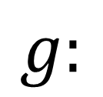
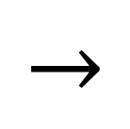
(Perturbed) objective is “L-convex”
$$n$$
height
$$y$$
$$\left\lceil \frac{x+y}{2}\right\rceil$$
$$g:$$
$$→$$
$$ℝ∪\{∞\}$$
$$\left\lfloor \frac{x+y}{2}\right\rfloor$$
$$x$$
$$0$$
trivalent tree
$$g\left(x\right)+g\left(y\right)≥g\left(\left\lceil \frac{x+y}{2}\right\rceil \right)+g\left(\left\lfloor \frac{x+y}{2}\right\rfloor \right)$$
Favati-Tardella, Murota, Fujishige for $ℤ^{n}$, H. beyond $ℤ^{n}$
Notes:
We can perturb the problem so that the objective is an L-convex function on
n product of the gridｓ on product of two trees, where orientation is given in this way.
We can naturally define the discrete midpoint convexity, and define L-convexity.

Slide 10
General framework for L-convex func. minimization
Local opt = Global opt ---> Steepest Descent Algorithm
$$x_{n}$$
$$×$$
$$×⋯ ×$$
$$x_{1}$$
$$x_{2}$$
Local problem <--- Minimizing “submodular” func. on
$$×$$
$$×⋯ ×$$
# iterations $≈$ $l_{∞}$-distance between init and opt
= $O(m \text{log} |T|)$ (in this case)
Notes:
Now we can apply the framework of steepest descent algorithm.
The discrete neighborhood is defined in this way.
Local problem is minimization of a new kind of submodular function defined on this semilattice.
There are the same l-infty bound of iterations. In this case, by the way of perturbation,
it is bounded by O(m log k).

Slide 11
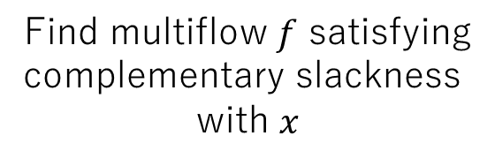
Algorithm
If $g\left(y\right)<g(x)$, then $x≔y$
Find multiflow $f$ satisfying
complementary slackness
with $x$
opt. check at $x$
$$=$$
$$O(m \text{log}\left|T\right|)$$
edge-cost
$$f↦(f\left(e\right):e∈E)$$
bisubmodular flow
feasibility
SFM on ${( )}^{n}$
project
lift
trivalentness
local minimizer $y$ around $x$
submodular flow
feasibility
$x:$non-opt
$x:$opt
min cut
max. submodular flow problem
$$O(\text{MSF}\left(n,m,1\right))$$

Slide 12
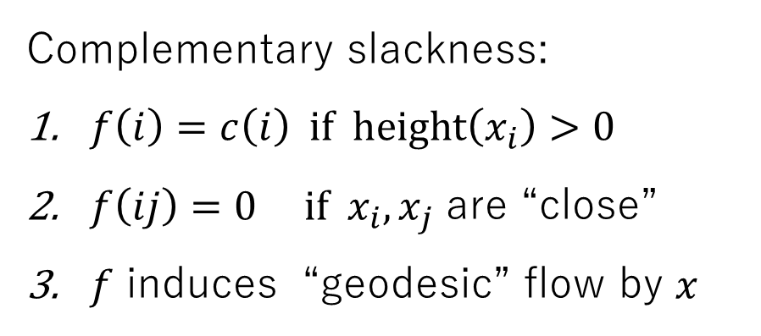
Why (bi)submodular flow ?
$$N=(V,E,c,T)$$
$$i$$
height
$$x$$
$$s$$
$$t$$
$$x_{i}$$
$$0$$
$$t$$
$$s$$
Complementary slackness:
$f\left(i\right)=c\left(i\right) \text{if} \text{height}\left(x_{i}\right)>0$
$f\left(ij\right)=0 \text{if} x_{i},x_{j}$ are “close”
$f$ induces “geodesic” flow by $x$

Slide 13
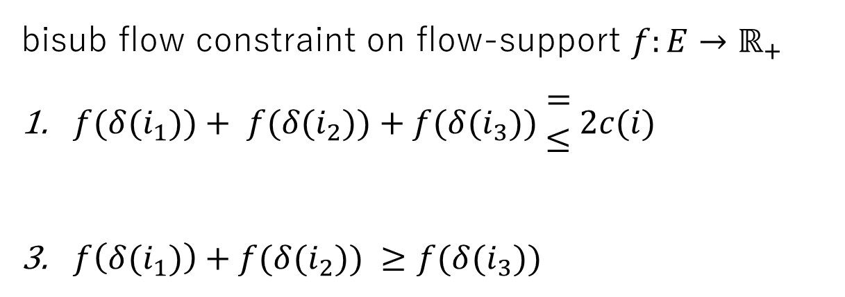
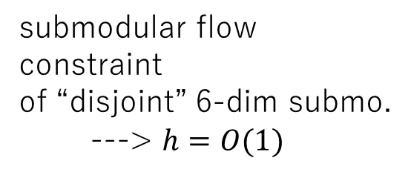
submodular flow
constraint
of “disjoint” 6-dim submo.
---> $h=O(1)$
lift
$$i_{3}$$
$$1$$
$$1/2$$
$$i_{1}$$
$$i_{2}$$
$$t$$
bisub flow constraint on flow-support $f:E→ℝ_{+}$
$f(δ{(i}_{1}))+ f(δ{(i}_{2}))+f({δ(i}_{3})) \begin{matrix}= \\ ≤\end{matrix} 2c(i)$
$f\left(δ(i_{1})\right)+f({δ(i}_{2})) ≥f({δ(i}_{3}))$
$$s$$

Slide 14
Summary, remark, question
First combinatorial strong polytime algo. for max. node-cap. free mulitflow
DCA idea brings combin. polytime algo. for another mincost multilfow problem [H.15]
?? more direct combinatorial algorithm without perturbation
?? SFM on
$$×$$
$$×⋯ ×$$
Thank you for your attention

