Slide 1
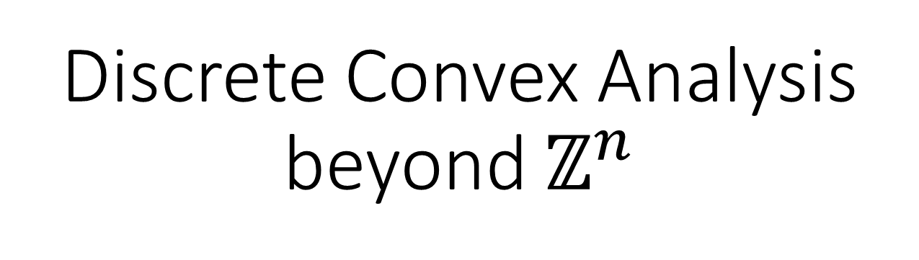
Discrete Convex Analysis beyond $ℤ^{n}$
Hiroshi Hirai
University of Tokyo
JCCA2016 Kyoto
May 24 2016

Slide 2
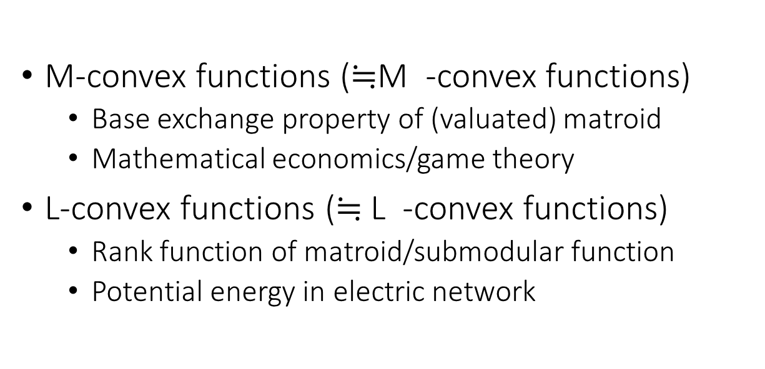
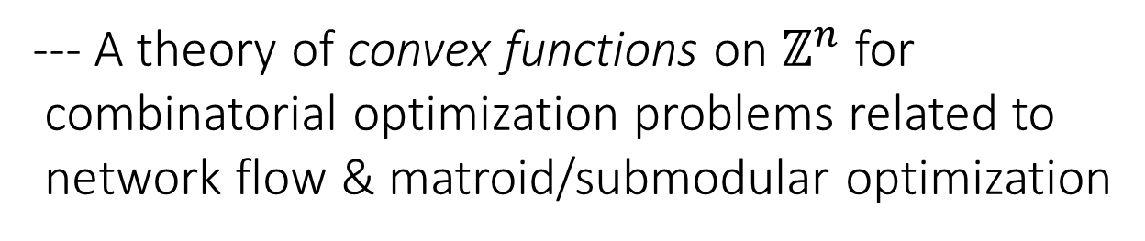
Discrete Convex Analysis (Murota 96 ～)
Fujishige, Shioura, Tamura,...
--- A theory of convex functions on $ℤ^{n}$ for
combinatorial optimization problems related to
network flow & matroid/submodular optimization
M-convex functions ($≒$M -convex functions)
  Base exchange property of (valuated) matroid
  Mathematical economics/game theory
L-convex functions ($≒$L -convex functions)
  Rank function of matroid/submodular function
  Potential energy in electric network
♮
Legendre
conjugate
♮

Slide 3

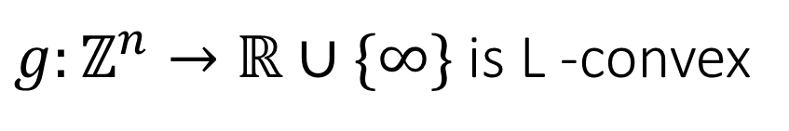




L -convex function
♮
(Favati-Tardella 90, Murota 96,
Fujishige-Murota 00)
♮
$g:ℤ^{n}→ℝ∪\{∞\}$ is L -convex
$$⇔$$
$g\left(x\right)+g\left(y\right) ≥g\left(\left\lceil \frac{x+y}{2}\right\rceil \right)+g\left(\left\lfloor \frac{x+y}{2}\right\rfloor \right)$ $(x,y∈ℤ^{n})$
$$x$$
$$\left\lceil \frac{x+y}{2}\right\rceil$$
$$\left\lfloor \frac{x+y}{2}\right\rfloor$$
$$y$$

Slide 4




Important properties of L -convex func.
♮
Local opt = Global opt ---> Steepest Descent Algo.
Local problem = Submodular Function Minimization
$f\left(p\right)+f\left(q\right) ≥f\left(p∧q\right)+f\left(p∨q\right) (p,q∈{\{0,1\}}^{n}$)
# iterations $≈$ $l_{∞}$-distance between initial $x$ and opt.
$$x+{\{0,1\}}^{n}$$
$$x$$
$$x−{\{0,1\}}^{n}$$
Kolmogorov-Shioura 09, Murota-Shioura14

Slide 5
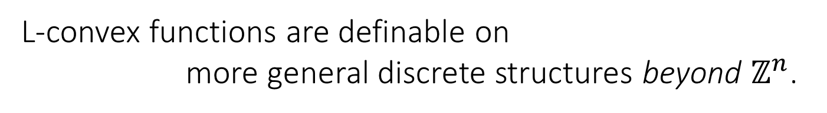
L-convex functions are definable on
more general discrete structures beyond $ℤ^{n}$.
SDA framework brings efficient polynomial time algorithms
to problems for which such algo. were not known:
Minimum cost multiflow / terminal backup [H.15]
Node-capacitated multiflow / node-multiway cut [H.15]
Multifacility location problem [H.13]
※ we omit ♮

Slide 6



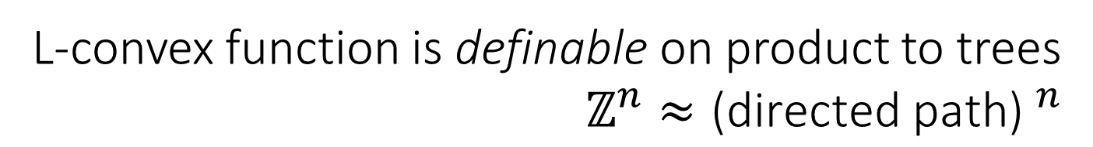









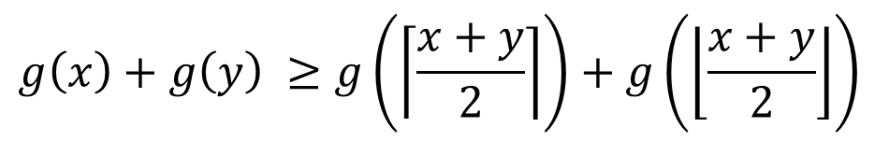


L-convex function is definable on product to trees
$ℤ^{n}≈{\text{(}\text{directed} \text{path}\text{)} }^{n}$
$$x_{1}$$
$$y_{2}$$
$$x_{n}$$
$$\left\lceil \frac{x_{1}+y_{1}}{2}\right\rceil$$
$$y_{1}$$
$$\left\lfloor \frac{x_{2}+y_{2}}{2}\right\rfloor$$
$$×$$
$$× ⋯ ×$$
$$\left\lfloor \frac{x_{1}+y_{1}}{2}\right\rfloor$$
$\left\lfloor \frac{x_{n}+y_{n}}{2}\right\rfloor$=$\left\lceil \frac{x_{n}+y_{n}}{2}\right\rceil$
$$x_{2}$$
$$\left\lceil \frac{x_{2}+y_{2}}{2}\right\rceil$$
$$y_{n}$$
$$g\left(x\right)+g\left(y\right) ≥g\left(\left\lceil \frac{x+y}{2}\right\rceil \right)+g\left(\left\lfloor \frac{x+y}{2}\right\rfloor \right)$$
$$(x,y ∈ T_{1}×T_{2}×⋯×T_{n})$$
c.f. Kolmogorov 11

Slide 7

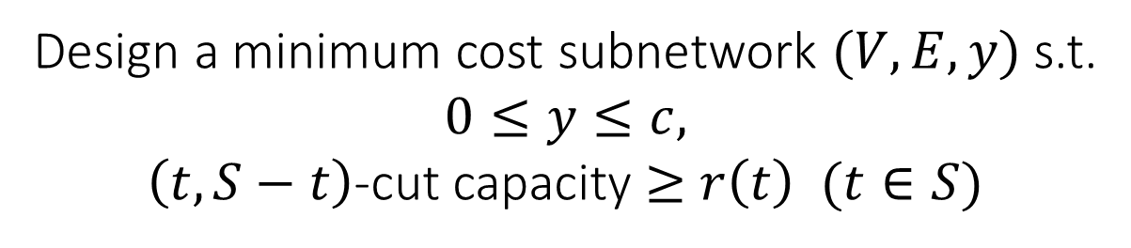


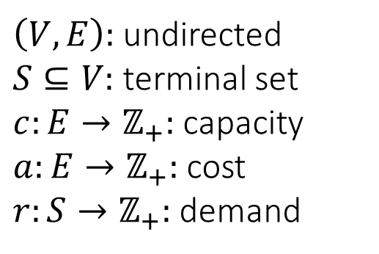
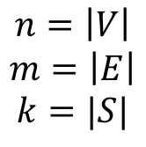
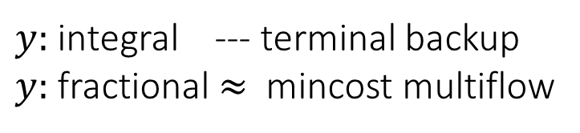

I. Mincost multiflow / terminal backup
$\left(V,E\right):$ undirected
$S⊆V:$ terminal set
$c:E→ℤ_{+}:$ capacity
$a:E→ℤ_{+}:$ cost
$r:S→ℤ_{+}:$ demand
$$x$$
$$t$$
$$r(t)$$
$$n=\left|V\right|$$
$$m=\left|E\right|$$
$$k=|S|$$
$$\sum_{e∈E}{a\left(e\right)y(e)}$$
Design a minimum cost subnetwork $(V,E,y)$ s.t.
$$0≤y≤c,$$
$\left(t,S−t\right)$-cut capacity $≥$ $r\left(t\right)$ $(t∈S)$
$y:$ integral --- terminal backup
$y:$ fractional $≈$ mincost multiflow

Slide 8
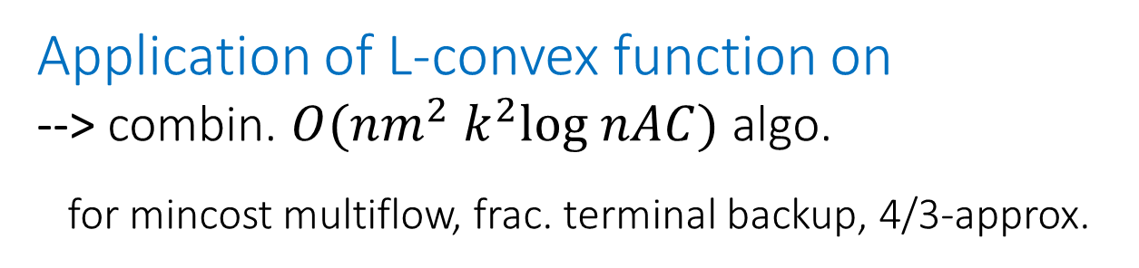
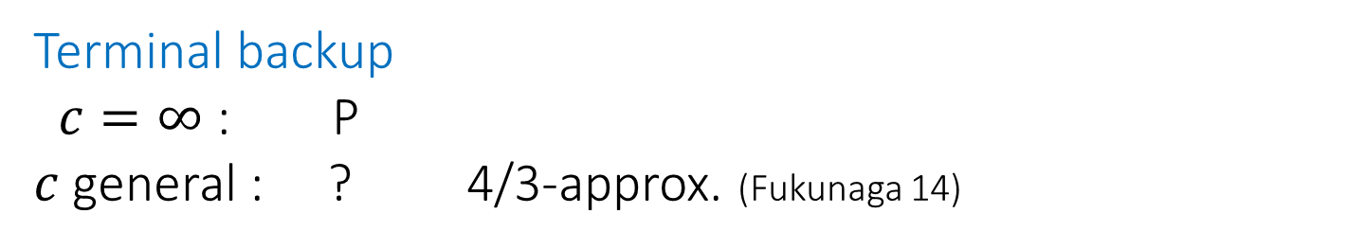


Terminal backup
$c=∞$ : P
$c$general : ? 4/3-approx. (Fukunaga 14)
Anshelevich-Karagiozova 11, Bernath-Kobayashi-Matsuoka 13
rounding LP-opt
obtained by ellipsoid
Fractional terminal backup
half-integrality + multiflow decom. (Fukunaga 14)
$$≒$$
Mincost multiflow
combinatorial weakly polytime algo. O(??)
(Goldberg-Karzanov 97)
$$n$$
Application of L-convex function on
--> combin. $O(nm^{2} k^{2}\text{log} nAC)$ algo.
for mincost multiflow, frac. terminal backup, 4/3-approx.

Slide 9
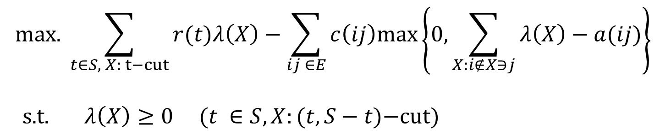
LP-dual of fractional terminal backup
$$\text{max}\text{. }\sum_{t∈S, X: t−cut}{r(t)λ\left(X\right)}−\sum_{ij ∈E}{c\left(ij\right)\text{max}\left\{0,\sum_{X:i∉X∋j}{λ\left(X\right)}−a(ij)\right\}}$$
$\text{s}\text{.}\text{t}\text{.} λ\left(X\right)≥0 (t ∈S, X:(t,S−t\text{)−}\text{cut}\text{)}$
uncrossing

Slide 10
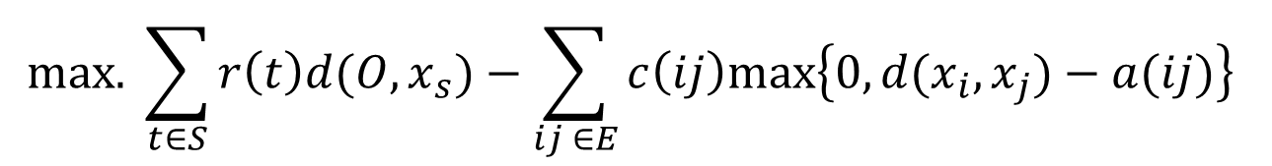



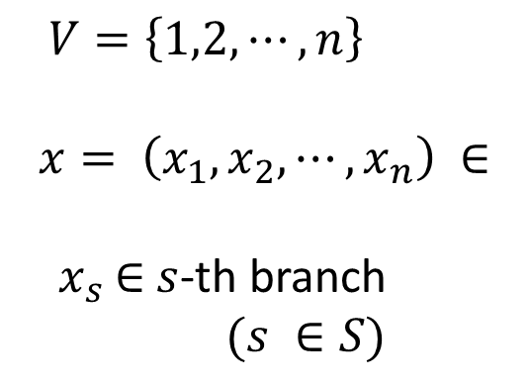
L-concave func.
$$\text{max}\text{. }\sum_{t∈S}{r\left(t\right)d(O,x_{s})}−\sum_{ij ∈E}{c\left(ij\right)\text{max}\left\{0, d(x_{i},x_{j})−a(ij)\right\}}$$
$$n$$
s.t.
$$1/2$$
$V=\left\{1,2,⋯,n\right\}$
$$x= \left(x_{1},x_{2},⋯,x_{n}\right) ∈$$
${ x}_{s}$ $∈$ $s$-th branch
$(s ∈S)$
$$O$$
half-integrality

Slide 11
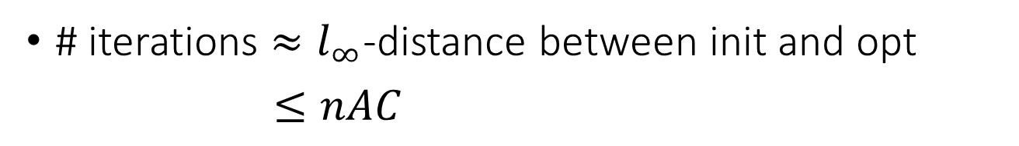












Local opt = global opt ---> Steepest Descent Algo.
$$x_{n}$$
$$×$$
$$×⋯×$$
$$x_{1}$$
$$x_{2}$$
Local prob. <--- Minimization of k-submodular func.
$$u$$
$$n$$
(Huber-Kolmogorov 12)
$$f:$$
$$→ℝ∪\{∞\}$$
$$u⊔v$$
$$v$$
$$f\left(p\right)+f\left(q\right)≥f\left(p∧q\right)+f\left(p⊔q\right)$$
# iterations $≈l_{∞}$-distance between init and opt
$≤nAC$

Slide 12
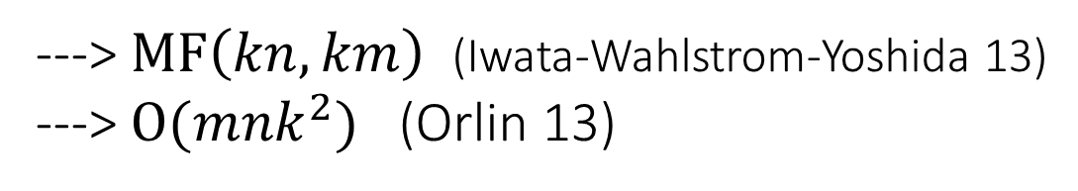
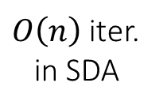

Our k-submodular func. is network-representable
---> $\text{MF}\left(kn,km\right)$ (Iwata-Wahlstrom-Yoshida 13)
---> $O({mnk}^{2})$ (Orlin 13)
Domain-scaling + proximity theorem
$O\left(n\right)$ iter.
in SDA
$\text{log} nAC$ scaling phases
Total: $O\left({mn}^{2} k^{2}\text{log} nAC\right)$-time
Recovering primal opt from dual opt by max-flow
(nontrivial, omitted)

Slide 13

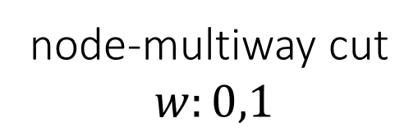
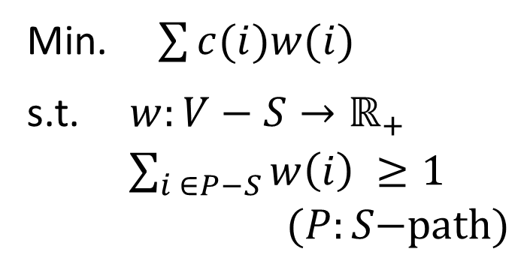
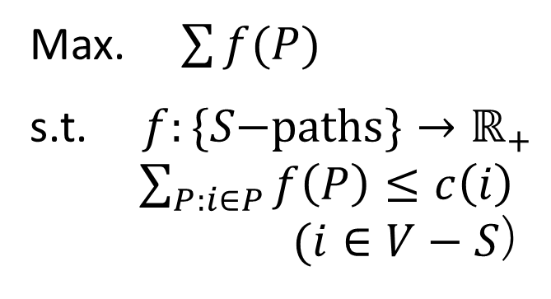
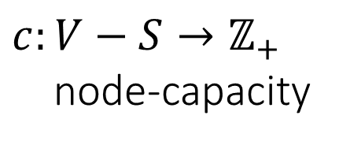
II. Node-cap. multiflow / node-multiway cut
$$N=(V,E,c,S)$$
$c:V−S→ℤ_{+}$
node-capacity
node-multiway cut
$$w:0,1$$
P:
D:
LP-relax.
Max. $\sum{f(P)}$
s.t. $f:\{S\text{−}\text{paths}\}→ℝ_{+}$
$\sum_{P:i∈P}{f\left(P\right)}≤c\left(i\right)$
$(i∈V−S$)
Min. $\sum{c(i)w(i)}$
s.t. $w:V−S→ℝ_{+}$
$\sum_{i ∈P−S}{w\left(i\right)} ≥1$
$(P:S\text{−}\text{path}\text{)}$

Slide 14
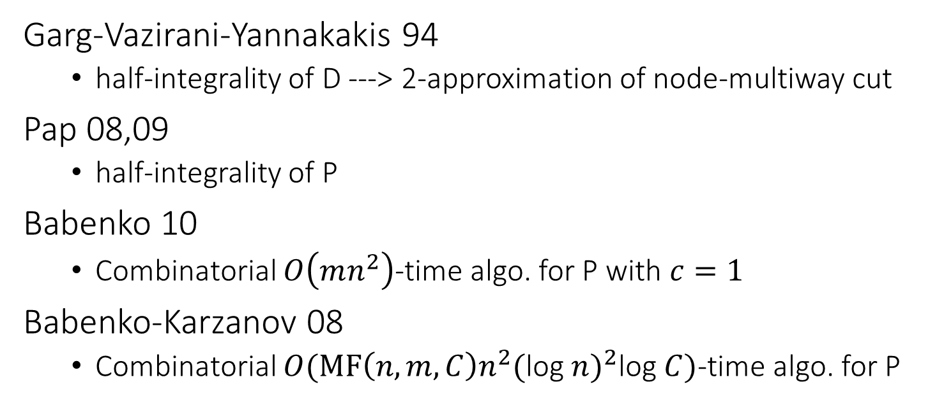

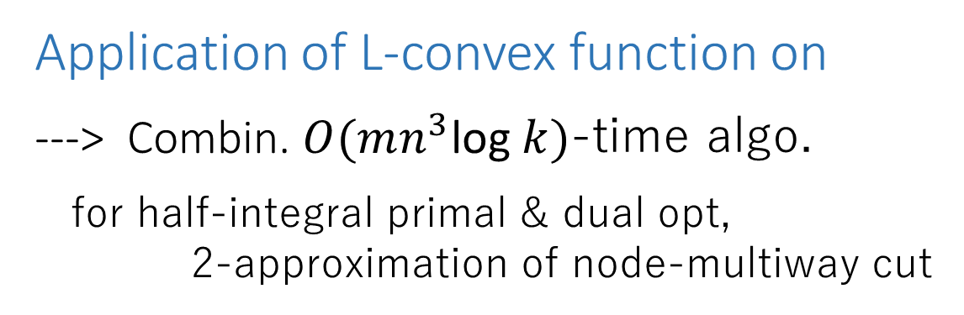
Garg-Vazirani-Yannakakis 94
  half-integrality of D ---> 2-approximation of node-multiway cut
Pap 08,09
  half-integrality of P
Babenko 10
  Combinatorial $O\left(mn^{2}\right)$-time algo. for P with $c=1$
Babenko-Karzanov 08
  Combinatorial $O(MF\left(n,m,C\right)n^{2}{(\text{log} n)}^{2}\text{log} C)$-time algo. for P
depend on ellipsoid
$$n$$
Application of L-convex function on
---> Combin. $O(mn^{3}\text{log} k)$-time algo.
for half-integral primal & dual opt,
2-approximation of node-multiway cut

Slide 15

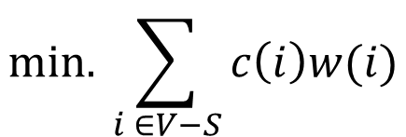

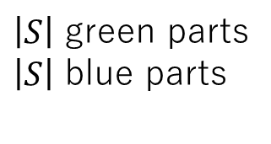

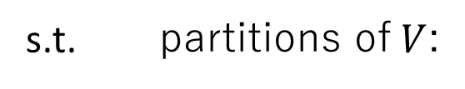




Garg-Vazirani-Yannakakis half-integrality
$$\text{min}\text{. }\sum_{i ∈V−S}{c\left(i\right)w(i)}$$
s.t. partitions of$V$:
Each edge
belongs to same part, or
connects “adjacent” parts
or “top” part
$\left|S\right|$ green parts
$\left|S\right|$ blue parts
$$w_{i}=1$$
$$w_{i}=0$$
$$s$$
Each green part
contains
exactly one terminal
$$1/2$$
$$0$$
$$t$$
Vazirani: Approximation Algorithms,
Section 19.3
$$u$$

Slide 16

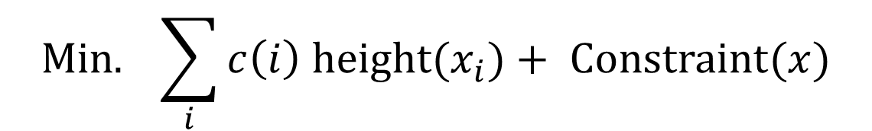





$$\{0,∞\}$$
$$\text{Min}\text{.} \sum_{i}{c\left(i\right) \text{height}(x_{i})+ \text{Constraint}(x)}$$
$$∈$$
$$n$$
height
1
$$\text{s}\text{.}\text{t}\text{. }$$
$$x= \left(x_{1},x_{2},⋯,x_{n}\right) ∈$$
1/2
$V=\left\{1,2,⋯,n\right\}$
0
c.f. submodular interpretation: Y. Iwata 2013
There are several technical difficulties
to treat this objective.
---> perturbation (details are omitted)

Slide 17
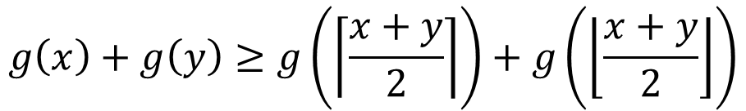
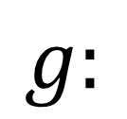




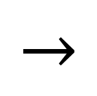



(Perturbed) objective is “L-convex”
$$n$$
height
$$y$$
$$\left\lceil \frac{x+y}{2}\right\rceil$$
$$g:$$
$$→$$
$$ℝ∪\{∞\}$$
$$\left\lfloor \frac{x+y}{2}\right\rfloor$$
$$x$$
$$0$$
trivalent tree
$$g\left(x\right)+g\left(y\right)≥g\left(\left\lceil \frac{x+y}{2}\right\rceil \right)+g\left(\left\lfloor \frac{x+y}{2}\right\rfloor \right)$$

Slide 18





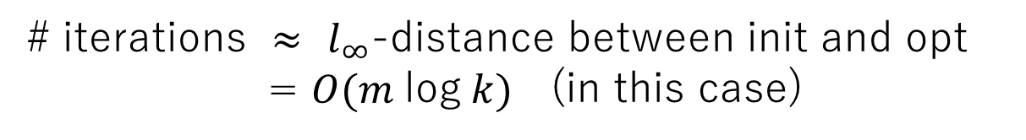


Local opt = Global opt ---> Steepest Descent Algorithm
$$x_{n}$$
$$×$$
$$×⋯ ×$$
$$x_{1}$$
$$x_{2}$$
Local problem <--- Minimizing “submodular” func. on
$$×$$
$$×⋯ ×$$
# iterations $≈$ $l_{∞}$-distance between init and opt
= $O(m \text{log} k)$ (in this case)

Slide 19


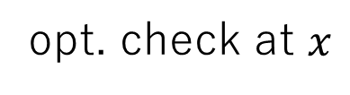
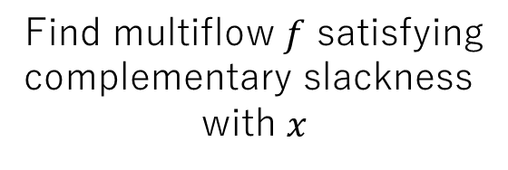




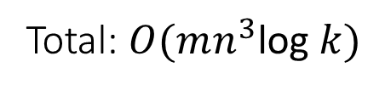
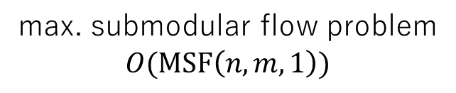

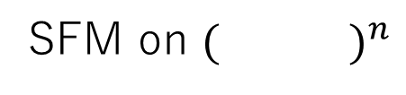

Algorithm
If $g\left(y\right)<g(x)$, then $x≔y$
Find multiflow $f$ satisfying
complementary slackness
with $x$
opt. check at $x$
$$=$$
$$O(m \text{log} k)$$
edge-cost
$$f↦(f\left(e\right):e∈E)$$
bisubmodular flow
feasibility
SFM on ${( )}^{n}$
project
lift
trivalentness
local minimizer $y$ around $x$
submodular flow
feasibility
$x:$non-opt
$x:$opt
min cut
max. submodular flow problem
$$O(\text{MSF}\left(n,m,1\right))$$
Total: $O(mn^{3}\text{log} k)$
Fujishige-Zhang 92: $O(n^{3})$

Slide 20

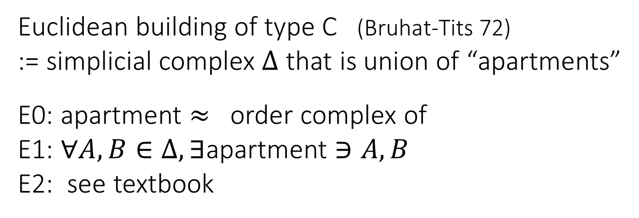

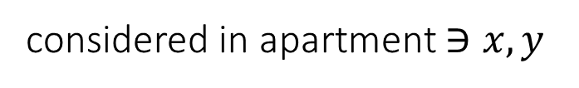

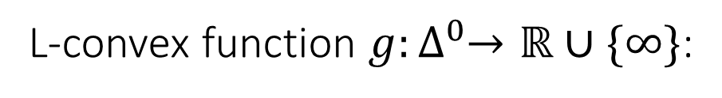
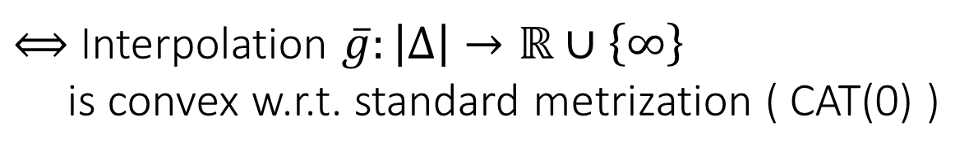
View from building theory
Euclidean building of type C (Bruhat-Tits 72)
:= simplicial complex $Δ$ that is union of “apartments”
E0: apartment $≈$ order complex of
E1: $∀A,B∈Δ,∃$apartment $∋A,B$
E2: see textbook
$$×$$
$$×⋯×$$
$$≈ℤ^{n}$$
considered in apartment $∋x,y$
L-convex function $g:∆^{0}→ℝ∪\{∞\}$:
$g\left(x\right)+g\left(y\right)≥g\left(\left\lceil \frac{x+y}{2}\right\rceil \right)+g\left(\left\lfloor \frac{x+y}{2}\right\rfloor \right)$ $(x,y ∈∆^{0}$)
Lovasz extension
$⟺$ Interpolation $\overline{g}:\left|Δ\right|→ℝ∪\left\{∞\right\}$
is convex w.r.t. standard metrization ( CAT(0) )

Slide 21

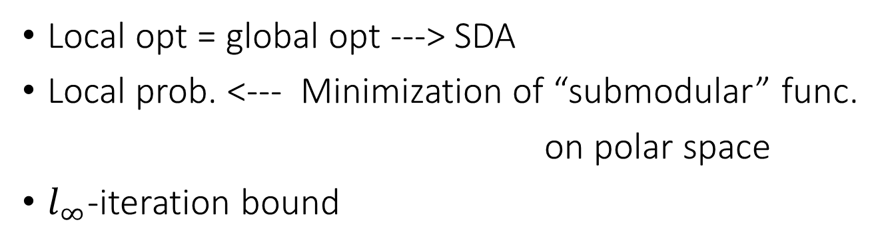


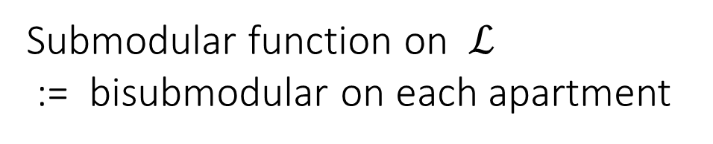
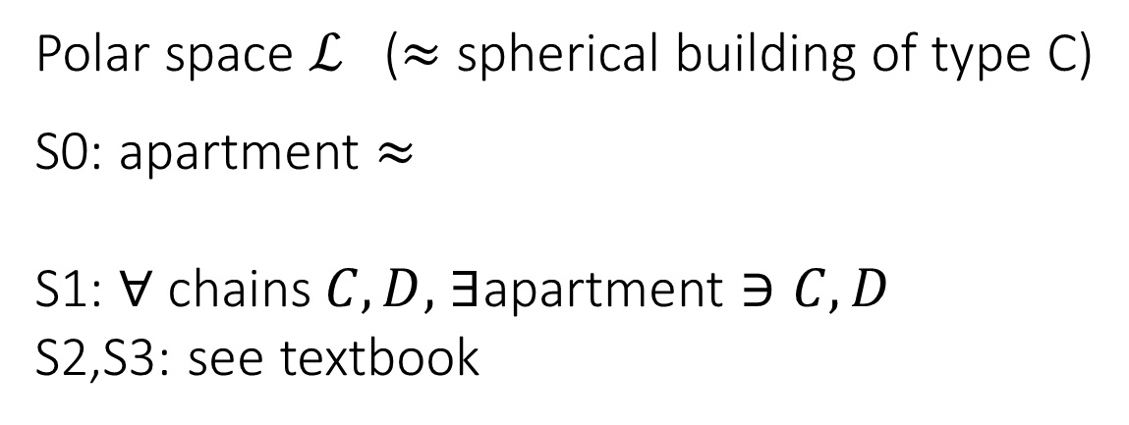
Local opt = global opt ---> SDA
Local prob. <--- Minimization of “submodular” func.
on polar space
$l_{∞}$-iteration bound
Polar space $ℒ$ ($≈$ spherical building of type C)
S0: apartment $≈$
S1: $∀$ chains$C,D,$ $∃$apartment $∋C,D$
S2,S3: see textbook
(Veldkamp 59, Buekenhout-Shult 73, Tits 74)
$$×$$
$$×⋯×$$
$$≈{\{−1,0,1\}}^{n}$$
Submodular function on $ℒ$
:= bisubmodular on each apartment

Slide 22
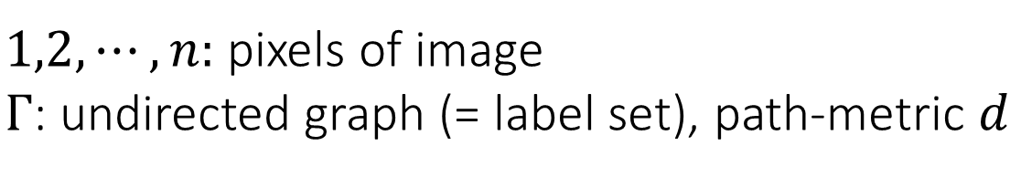
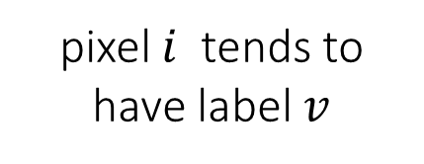
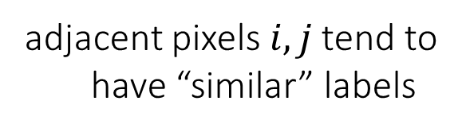


III. Multifacility location problem
(alias: minimum 0-extension problem)
$1,2,⋯,n:$ pixels of image
$Γ$: undirected graph (= label set), path-metric $d$
Assign label $x_{1},x_{2},⋯,x_{n}∈Γ$ s.t.
“penalty” is minimum:
$$\sum_{v,i}{b_{vi}d\left(v,x_{i}\right)}+\sum_{i,j}{c_{ij}d(x_{i},x_{j})}$$
pixel $i$ tends to
have label $v$
adjacent pixels$i,j$ tend to
have “similar” labels

Slide 23

Fomulated in facility location theory 70’s
Labeling problems in vision & machine learning
Optimization over $Γ×Γ×⋯×Γ$
Minimum cut problem: $Γ=K_{2}$ ---> P
Multiway cut problem: $Γ=K_{k}$ ---> NP-hard
Complexity classification w.r.t. $Γ$ (Chepoi 96, Karzanov 98)
What are graphs on which multifac. is tractable ?

Slide 24



Dichotomy Theorem
[H. 13] If $Γ$ is orientable modular, multifac. is in P
[Karzanov 98] Otherwise, multifac. is NP-hard
L-convex functions on oriented modular graphs
&
Submodular functions on modular semilattices
tree, cube, modular lattice
their product & amalgam,
Euclidean building (type C)
-- oriented/able modular graph $⊃$
-- modular semilattice $⊃$
modular lattice, polar space,..
(Bandelt-Van de Vel-Verheul 93)
-- generalize previous/other L-convex and submo. func.

Slide 25



$G$: modular $⟺$
$∀v_{1},v_{2}, v_{3},∃z, d\left(v_{i},v_{j}\right) =d\left(v_{i},z\right)+d(z,$ $v_{j})$ $(1≤i<j≤3)$
$G$: orientable $⟺∃$ orientation s.t.
$∀$4-cycle is oriented as
modular semilattice $⟺$ Hasse diagram is oriented modular

Slide 26

$x↦\sum_{v,i}{b_{vi}d\left(v,x_{i}\right)}+\sum_{i,j}{c_{ij}d(x_{i},x_{j})}$
is L-convex on $\vec{Γ}×\vec{Γ}×⋯×\vec{Γ}$
Local opt = global opt ----> SDA
Local prob. <---- SFM on modular semilattice
-- tractable in VCSP model (this case)
(<--- application of Thapper-Zivny 12)
$l_{∞}$-iteration bound
---> Multifac. on om-graph $Γ$is tractable
※ def of L-convex/submo are omitted
Notes:
Then the objective of multifacitiy location problem is L-convex in the Cartesian product of oriented modular graphs.
We can apply the framework of steepest descent algorithm to minimize this objective as before.
Here the local problem is minimization of submodular function on modular semilattice, which is tractbale in VCSP model.
VCSP is an optimization problem whose the objective function is given as sum of functions of small number of variables.
This is an application of Thapper-Zivny criterion for tractability of Valued CSP.
Also linfty bound holds.
Consequently multifacity location problem on orientable modular graph is polynomial solvable.

Slide 27

Summary, remarks, questions
L-convex functions on graphs and their algorithmic applications
I believe that DCA beyond $ℤ^{n}$ is promising
A step to (discrete) convex optimization theory over
non-Euclidean/non-manifold spaces
More applications ??
SFM on modular semilattice ??
M-convexity, conjugacy ??
....

Slide 28
Reference
H. Hirai: Discrete convexity and polynomial solvability in minimum 0-extension problems, SODA13, MPA16.
J. Chalopin, V. Chepoi, H. Hirai, D. Osajda: Weakly modular graphs and nonpositive curvature, 2014, arXiv.
H. Hirai: L-extendable functions and a proximity scaling algorithm for minimum cost multiflow problem, DISOPT15.
H. Hirai: A dual descent algorithm for node-capacitated multiflow problems and its applications, 2015, arXiv.
H. Hirai: L-convexity on graph structures, 2016, preprint
Thank you for your attention !

