Slide 1
Uniform Semimodular Lattice, Valuated Matroid, & Euclidean building
Hiroshi Hirai
University of Tokyo
hirai@mist.i.u-tokyo.ac.jp
Combinatorial Geometries 2018:
matroid, oriented matroids, and applications
CIRM, Marseille-Luminy, France
9/27, 2018

Slide 2
Contents
Matroid $⇔$ geometric lattice
Valuated matroid
Uniform semimoduler lattice
examples
valuated matroid → uniform semimodular lattice
uniform semimodular lattice → valuated matroid
Connection to Euclidean building (option)
Concluding remarks

Slide 3
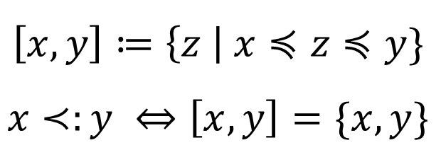
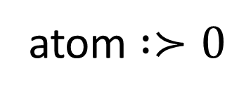
Lattice
Lattice := poset s.t. $∀x,y$
$∃$ join $x∨y=\text{unique} \text{min}\text{ \{ }z | x≼z≽y\}$,
meet $x∧y=uni\text{que} \text{m}\text{ax}\text{ \{ }z | x≽z≼y\}$
$$\left[x,y\right]≔\left\{z \right| x≼z≼y\}$$
$$x≺:y ⇔\left[x,y\right]=\{x,y\}$$
$$1$$
atom $:≻0$
$$0$$

Slide 4
Geometric Lattice
:= atomistic semimodular lattice
semimodular: $x∧a≺:a ⇒x≺:x∨a$
atomistic: $x=$ $⋁${ atoms $≼x$}
$$100$$
$$010$$
$$001$$
$$111$$
$$110$$
$$101$$
$$011$$
Ex: $E=\{a_{1},a_{2},…, a_{m}\}⊆ℝ^{n}$
$ℱ≔$ { subspaces spanned by subsets of $E$}
is a geometric lattice

Slide 5
Matroid $⇔$ Geometric Lattice
Birkhoff 1940
$\text{M}=\left(E,ℬ\right)$: matroid
$→$The family of flats $ℱ⊆2^{E}$is a geometric lattice
$ℒ:$geometric lattice $E:$ the set of atoms
$$ℬ≔\left\{B⊆E \right| ⋁B=1,minimal\}$$
$→(E,ℬ$) is a simple matroid
Goal: extend this equivalence to
valuated matroids

Slide 6
Valuated Matroid
Dress-Wenzel 1990
Valuated matroid $ω:ℬ→ℝ$ on matroid $M=(E,ℬ)$:
$[\text{VEXC}] ∀B,B^{′}∈ℬ, ∀e∈B∖B^{′}, ∃f∈B^{′}∖B$
$$ω\left(B\right)+ω(B^{′})≤ω\left(B−e+f\right)+ω(B^{′}−f+e)$$
Greedy algorithm
M-convexity, Discrete convex analysis (Murota 1996～)
Tropical Plucker vector (Speyer-Sturmfels 2004, Speyer 2008)

Slide 7
Representable Valuated Matroid
$E⊆{ℝ(t)}^{n}$
$ℬ ≔\{B⊆E| B$ is a basis $\text{of} {ℝ(t)}^{n}$ }
$ω:B↦ \text{deg} \text{det} B$ is a valuated matroid
[VEXC] = Tropicalization of Grassmann-Plucker relation
$$\text{det} B \text{det} B^{′}= \sum_{f}{±\text{det} (B−e+f) \text{det}\text{ (}B^{′}+f−e)}$$
$$(×,+)→(+,\text{max})$$
$\text{deg} \text{det} B+\text{deg} \text{det} B^{′}≤$
${\text{max}}_{f} \text{deg} \text{det} (B−e+f) \text{+ }\text{deg} \text{det}\text{ (}B^{′}+f−e)$

Slide 8
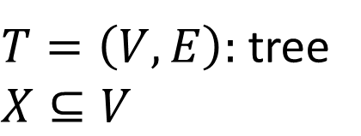
Tree Metric
$$y$$
$T=\left(V,E\right):$ tree
$X⊆V$
$$x$$
$$w$$
Four-point condition
$d_{T}\left(x,y\right)+d_{T}\left(z,w\right)$
$$≤\text{max}\text{ \{}d_{T}\left(x,w\right)+d_{T}\left(y,z\right),d_{T}\left(x,z\right)+d_{T}\left(y,w\right)\text{\}}$$
=VEXC
$$z$$
$d_{T}:\left(\begin{matrix}X \\ 2\end{matrix}\right)→ℝ$ is a valuated matroid

Slide 9
Result (H.18)
Matroid $⟺$ Geometric Lattice
integer-valued
Uniform
Semimodular Lattice
Valuated Matroid $⟺$

Slide 10
Definition
Geometric lattice = atomistic semimodular lattice
semimodular: $x∧a≺:a ⇒x≺:x∨a$
atomistic: $x=$ $⋁${ atoms $≼x$}
Uniform semimodular lattice
semimodular: $x∧a≺:a ⇒x≺:x∨a$
uniform:
$x↦{\left(x\right)}^{+}$ is automorphism
Ascending operation: ${\left(x\right)}^{+}≔⋁$ $\{y | y :≻x\}$
Lem: $\left[x,{\left(x\right)}^{+}\right]$ is a geometric lattice

Slide 11
Example 1: Integer Lattice $ℤ^{n}$
$+1$
$${\left(x\right)}^{+}$$
$$x$$
$ℤ^{n}$ is uniform (semi)modular lattice
$∧$ = min, $∨$ = max, ${\left(x\right)}^{+}=x+1$

Slide 12
Example 2. $Tree⊠$ $ℤ$
$${\left(x\right)}^{+}$$
$$x$$
→ $Tree⊠$ $ℤ$ is uniform (semi)modular lattice
corresponding to tree metric

Slide 13
Example 3. Lattice of Lattices
$E=\{a_{1},a_{2},…,a_{m}\}⊆{ℝ\left(t\right)}^{n}$
$$ℒ≔$$
$\{ ℝ{\left(t\right)}^{−}$-module generated by
$t^{z_{1}}a_{1},$ $t^{z_{2}}a_{2},…,$ $t^{z_{m}}a_{m} \}_{z∈ℤ^{m}}$
$$ℝ{\left(t\right)}^{−}:=\{p/q∈ℝ\left(t\right)|deg p≤\deg{q}\}$$
→ $ℒ$ is uniform semimodular lattice (with ${\left(L\right)}^{+}=tL$)
corresponding to $ω=$deg det
$$E=\{a_{1},a_{2},…, a_{m}\}⊆ℝ^{n}$$
Recall
$ℱ≔\{ ℝ$-vector space generated by $F \}_{F⊆E}$
is geometric lattice corresponding to $\text{M}(E)$

Slide 14
Proof outline
tropical geometry
tropical linear space,
tropical convexity
$⇒$
valuated matroid uniform semimodular lattice
$$⇐$$
ray, end, matroid at infinity
inspired by building theory:
spherical building at infinity
in Euclidean building

Slide 15
Valuated matroid $⇒$ Uniform semimodular lattice
$ω:$ valuated matroid on $(E,ℬ)$
${ℬ_{x}≔Argmax}_{B∈ℬ}ω\left(B\right)+\sum_{e∈B}{x(e)}$ $(x∈ℝ^{E})$
Tropical linear space (Dress-Terhalle 1993, Murota-Tamura 2001, Speyer 2008)
$𝒯\left(ω\right)≔$ $\left\{x∈ℝ^{E}\right| M_{x}=\left(E,ℬ_{x}\right) \text{is} \text{loop}$-$\text{free}\text{\}}$
Tropical convexity (Murota-Tamura 2001,Develin-Sturmfels 2004)
$$x∈𝒯\left(ω\right)⇒x+α1∈𝒯\left(ω\right)$$
$x,y$ $∈𝒯\left(ω\right)⇒\text{min}\text{(}x,y)$ $∈𝒯\left(ω\right)$
→ ${\left(∙\right)}^{+}$ automorphism
----> semimodularity
→ $𝒯\left(ω\right)∩ℤ^{E}$ is uniform semimodular lattice

Slide 16
Uniform semimodular lattice $⇒$ Valuated matroid
Geometric lattice → matroid on atoms
Uniform semimodular lattice
→ valuated matroid on
ends
????
Ray: $x^{0}≺x^{1}≺x^{2}≺…$
s.t. $\left[x^{0},x^{k}\right]=\left\{x^{0},x^{1},x^{2},…,x^{k}\right\} (∀k)$
End: an equivalence class of rays
by parallel relation $≈$
$\left(x^{k}\right)≈\left(y^{k}\right)⇔\left(x^{k}\right)∨y^{0}=(y^{k})∨x^{0}$

Slide 17
$E:$ the set of all ends
$x$-rays $⇔$ representatives of $E$
$${\left(x\right)}^{+}$$
geometric
lattice
atoms
$$x$$
Matroid at $x$: ${\text{M}}^{x}\text{=}\left(E,ℬ^{x}\right)$
Matroid at infinity: $M^{∞}\text{=}\left(E, \bigcup_{x}{ℬ^{x}} \right)$
→ Valuated matroid $ω$ on $M^{∞}$

Slide 18
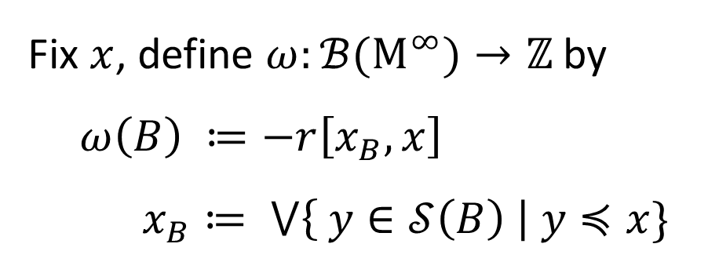
$𝒮\left(B\right)≔\left\{y \right| ℬ^{y}∋B\}{≈ℤ}^{n} (B∈ℬ(M^{∞}))$
$\sim$ apartement
$$𝒮\left(\{e,h\}\right)$$
$$x$$
$$h$$
$$x_{\{e,h\}}$$
$$g$$
$$𝒮\left(\{e,f\}\right){≈ℤ}^{2}$$
$$e$$
$$f$$
Fix $x$, define $ω:ℬ(M^{∞})→ℤ$ by
$ω\left(B\right) ≔−r\left[x_{B},x\right]$
$x_{B}≔ ⋁\left\{ y∈𝒮\left(B\right) \right| y≼x\}$
valuated
matroid

Slide 19
$ℒ→(E,ω) → 𝒯\left(ω\right)∩ℤ^{E} ≃ℒ$
$\left(E,ω\right)→ 𝒯\left(ω\right)∩ℤ^{E} → (E^{′},ω^{′})$
$$⊇$$
$\left(E,ω\right)$
Completion of valuated matroid
Dress-Terhalle 1993
c.f. p-adic completion

Slide 20
Connection to Euclidean building
Modular matroid
:= matroid whose lattice of flats
is a modular lattice
Modular valuated matroid
:= valuated matroid $(E,ω)$
s.t.$𝒯\left(ω\right)∩ℤ^{E}$ is a modular lattice
$⇕$
Birkhoff, Tits
$⇕$ H.17
Spherical building of type A
Euclidean building of type A
Modular lattice := lattice with $x≼z⇒\left(x∧y\right)∨z=x∧(y∨z)$
Cor (H.18) $ω:$ modular valuated matroid
$𝒯(ω)/ℝ1$ is a geometric realization of Euclidean building
For $E=𝒦^{n}$,$ω=\text{deg} \text{det}$:
A.Dress and W. Terhalle: The tree of life and other affine buildings,
ICM, Berlin 1998

Slide 21
Concluding remarks
Lattice-theoretic characterization to
valuated matroid & tropical linear space
Invariants for uniform semimodular lattices
e.g., characteristic polynomial ?
More application to tropical geometry ?

Slide 22
References
H. Hirai: Uniform modular lattice and
Euclidean building, arXiv, 2017.
H. Hirai: Uniform semimodular lattice and
valuated matroid, arXiv, 2018.
H. Hirai: Computing degree of determinant via
discrete convex optimization over
Euclidean building, arXiv, 2018.

Slide 23
Spherical/Euclidean building of type A
:= simplicial complex $∆ =⋃ \text{apartements}$ :
B0: apartment $≃$ Coxeter complex of type A.
B1: $A,B∈∆,∃\text{apartment} ∋A,B.$
B2: apartments $Σ,Σ^{′}∋A,B$
$⇒∃ \text{isomorphism} Σ→Σ^{′} \text{fixing} A,B.$
spherical
Euclidean
Coxeter
complex
of type A
Decomposition of $𝕊^{n−1}$
by $H_{ij}≔\{x|x_{i}=x_{j}\}$
Decomposition of $ℝ^{n}/ℝ1$
by $H_{ij,k}≔\{x|x_{i}=x_{j}+k\}$

Slide 24
Spherical building of type A = modular matroid
Thm (Tits)
Spherical building of type A
= chain complex of the subspace lattice of
generalized projective geometry
Thm (Birkhoff)
Modular geometric lattice
= the subspace lattice of generalized projective geometry
Spherical building of type A
= chain complex of modular geometric lattice

Slide 25
Euclidean building of type A = modular valuated matroid
Thm (H.17)
Euclidean building of type A
= complex of short chains$/\sim$ of a uniform modular lattice
short chain $⇔$ $x≺x_{1}≺…≺x_{m}≺{\left(x\right)}^{+}$
$x∼y ⇔x={\left(y\right)}^{+k}$ or $y={\left(x\right)}^{+k}$

